Slide 1



Moving Forward
with the
School Library Learning Commons

Slide 2
Themes
Designing for a Collaborative Physical LLC
Designing for a Collaborative Virtual LLC
Designing for Accessibility in the LLC
Designing for Responsive Print and Digital Collections
Designing for Creativity and Imagination
Designing for a Participatory School Culture

Slide 3
It’s time for the…
School Library Learning Commons
MAKEOVER CHALLENGE!

Slide 4
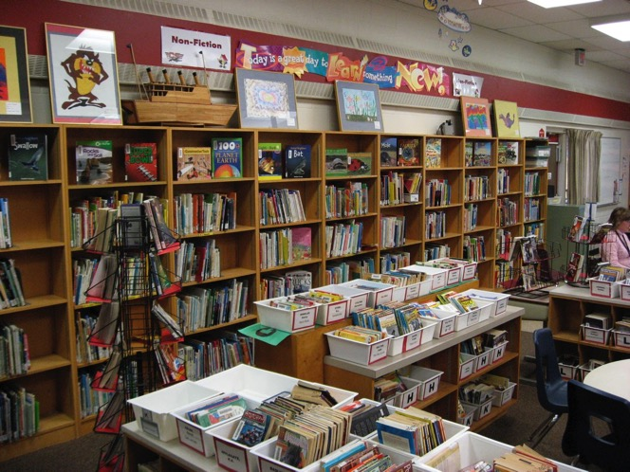
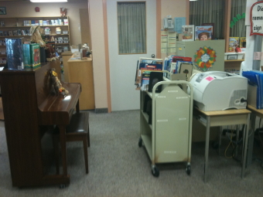
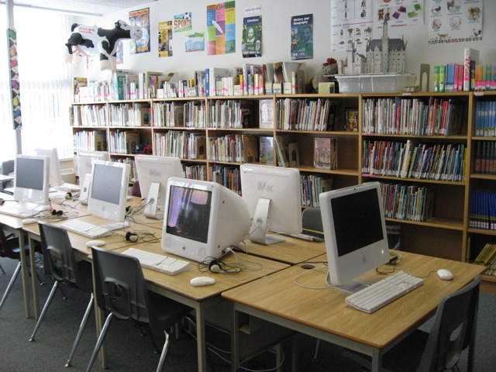


Slide 5







Slide 6
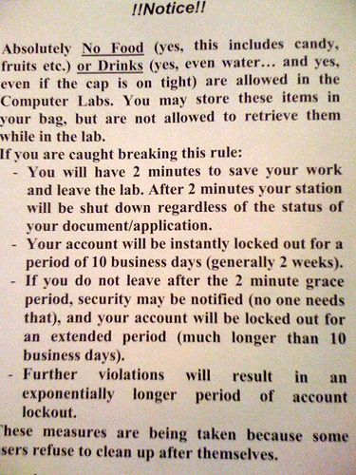
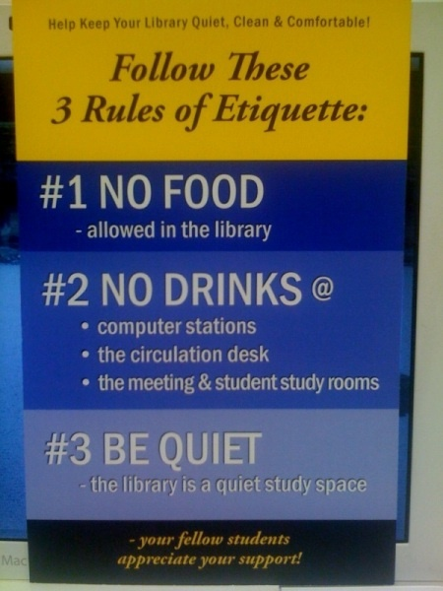
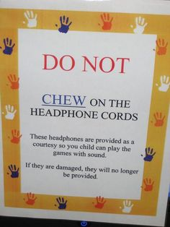

https://www.pinterest.com/anitabk/bad-library-signage/

Slide 7
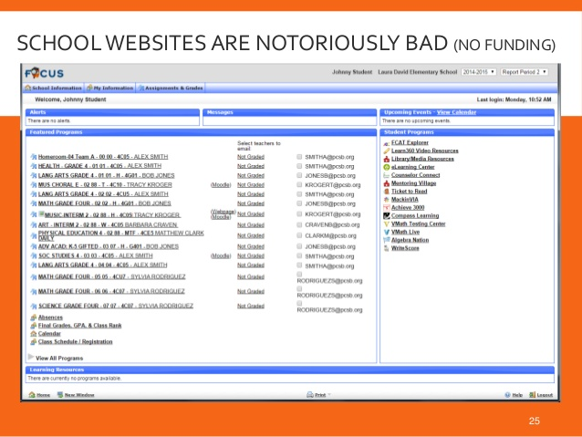
Image: SlideShare member delcerebro: http://www.slideshare.net/delcerebro/tampa-ux-meetup-october-2014-slides

Slide 8
School Library Learning Commons
MAKEOVER CHALLENGE!
http://www.bythebrooks.ca/bit15-yearlc/

Slide 9
How can we make the library more welcoming?
How can we empower students to navigate the library independently?
How can we make our physical collections more relevant and appealing?
How can we organize the library to foster collaborative learning?
How can we leverage the library’s virtual space to empower learners?
How can we help our school community to re-imagine THEIR
school library?

Slide 10

$$$$ What will it cost?
Complete
Makeover
Moderate
Cost
Minimal
Cost
Almost
Free

Slide 11
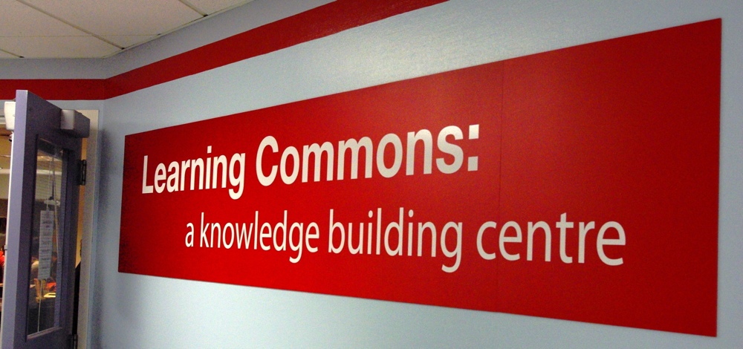
Your transformation may just inspire members of your school community to imagine THEIR library in new ways!

Slide 12
But you
CANNOT
do it
alone!

Slide 13
The Standards: A Whole School Approach
School Library Learning Commons
Physical & Virtual Learning Hub
Drives future-oriented teaching & learning
Inquiry, Problem Based Learning
Reading Thrives
Learning Literacies
Technology for Learning
Critical Thinking, Creativity, Innovation
Engagement with Information & Ideas
Everyone is a learner; everyone is a teacher working collaboratively toward excellence.

Slide 14
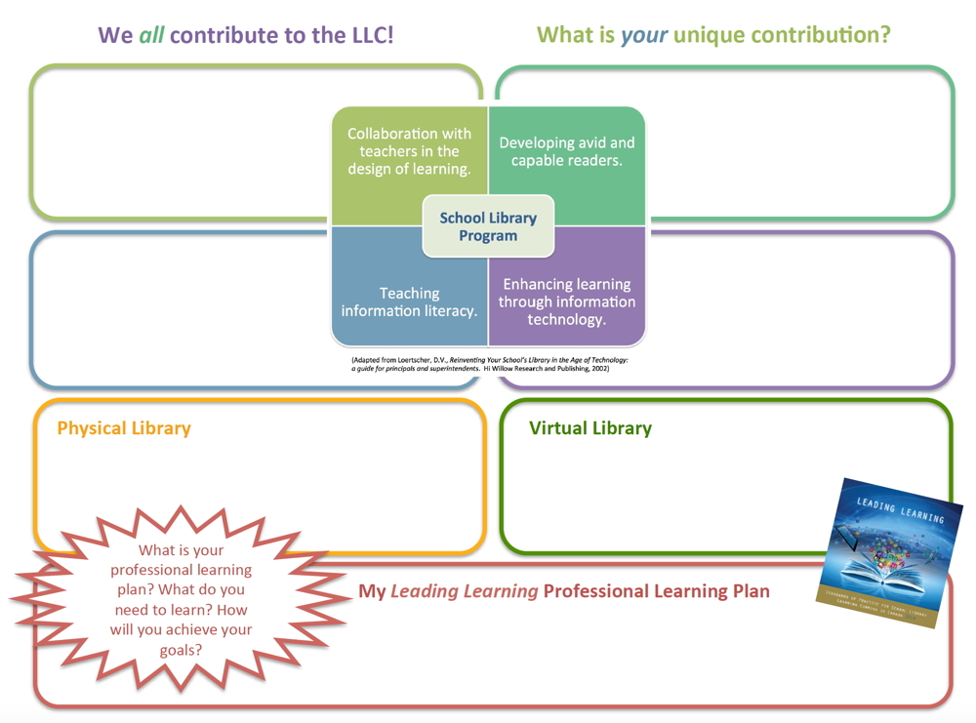

Slide 15
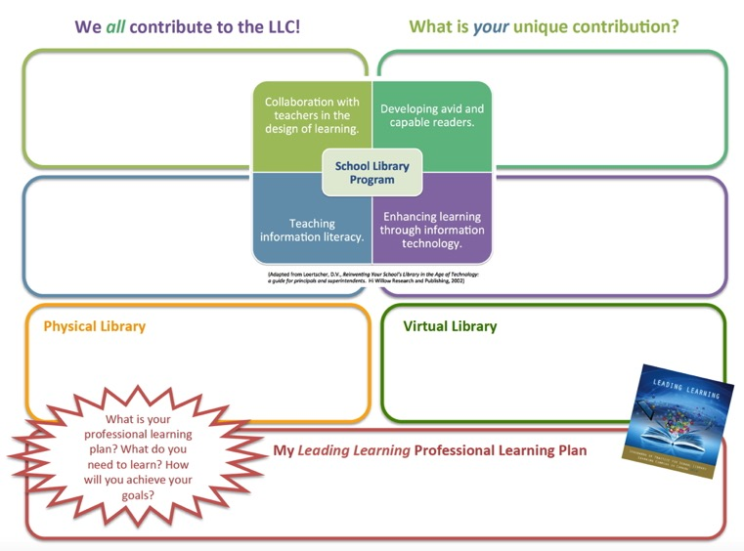
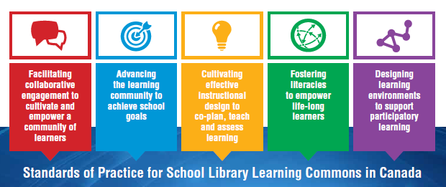
How will you address the gap analysis?

Slide 16

Collaborative Leadership Opportunities
Learning Commons Leadership Team
Principal and TL
TL and Teachers
TL and Specialists
TL and Students
Students and Students
TL / LLC Team with Parents and Community
District Level

Slide 17

No teacher-librarian?
  It’s even more important to engage teachers in leadership for the learning commons.
Think about leveraging alternative scenarios (LL Appendix 7)

Slide 18
Who will be on your team?
Learning Commons Team
“The Library Learning Commons Leadership Team represents the learning needs of the entire school community.”
page 22-23

Slide 19



The role of the principal
At the school level, the principal is key in establishing and encouraging working partnerships among staff and students. The principal must provide the climate for cooperation, experimentation and growth, The Learning Commons has great potential, but only when everyone participates.
School principals as curriculum leaders and site managers of their schools will provide the leadership, budgets and support for moving forward with library learning commons transitions and implementation of national and regional standards.

Slide 20
The Library Learning Commons Leadership Team represents the learning needs of the entire school community: teachers, students, community.
Central consultative & technical staff
PLNs
Districts
Associations
Networks
And don’t forget!
Opportunities
for
Broader Collaboration

Slide 21

Who should be on your school’s Learning Commons Leadership Team?
Consider ALL of the Leading Learning standards
Consider your own unique competencies/contributions
Identify missing/needed competencies/contributions
Think about your whole school community
Think about your peers across the school division
Be creative! Represent your ideas with diagrams, doodles, words – whatever works.

Slide 22
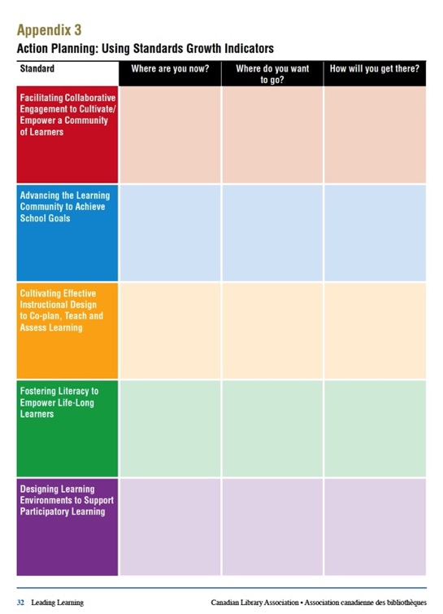

What are your next steps?

Slide 23



Tell Your Learning Commons Story!
January 2016

