Slide 1
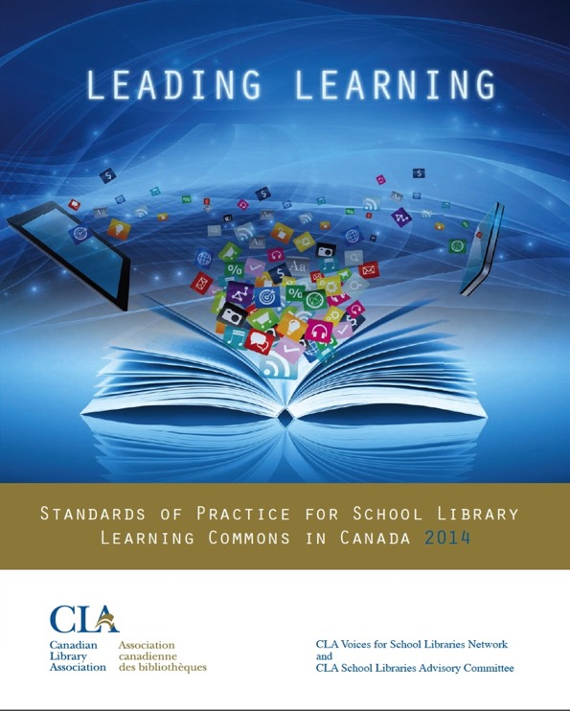
Leading Learning
Standards of Practice for School Library Learning Commons in Canada
Canadian Library Association (2014)

Slide 2
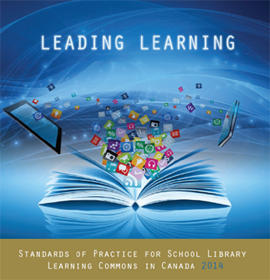
Full PDF document and bibliography available on the School Libraries in Canada website:
http://clatoolbox.ca/casl/slic/llsop.html
Linked from our session webpage: http://www.bythebrooks.ca/bit15-yearlc/

Slide 3
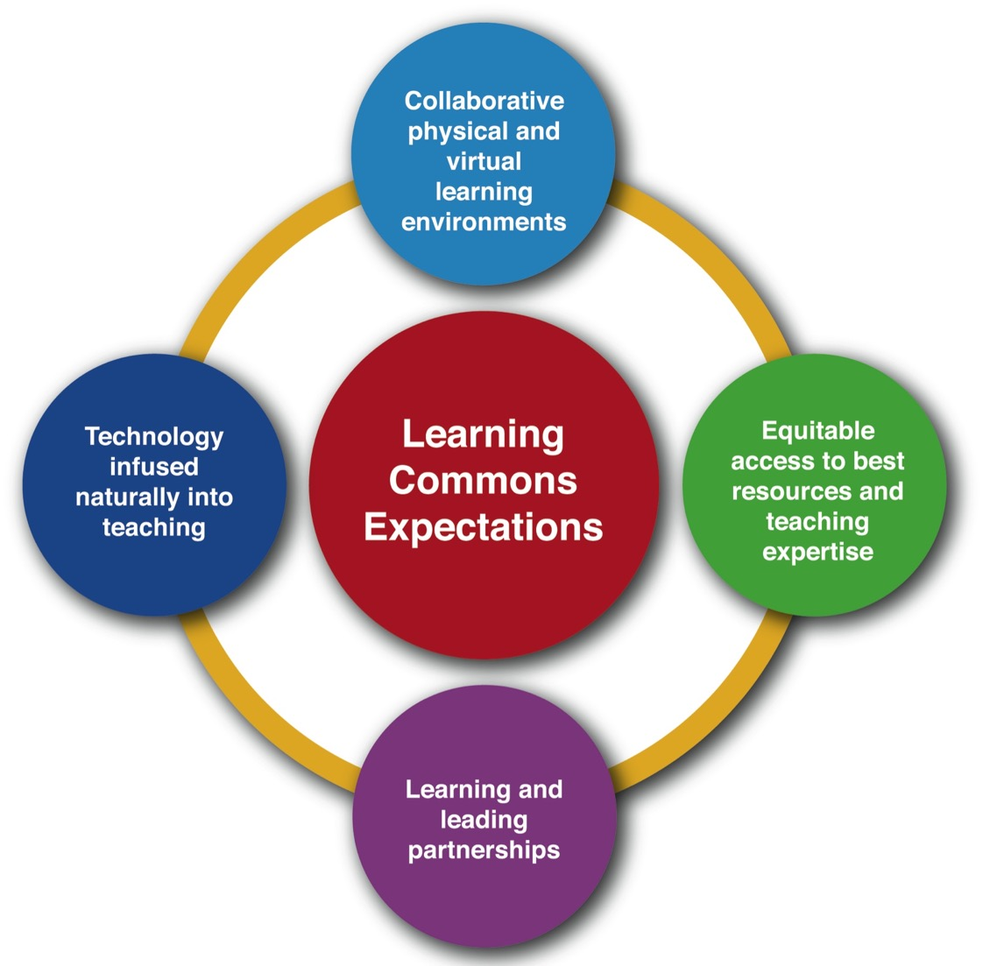

Slide 5
Yes, but how do
we measure our success with these ideas?

Slide 6
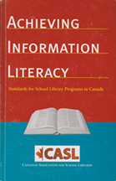
Canadian Library Association
(ATSL & CSLA) 2003
Canadian Library Association 2014
Measuring Outputs
Measuring Impact on Learning

Slide 7
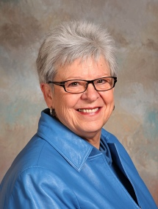
Evaluation provides the
data needed to ensure that the school library program and, in particular, the teacher-librarian are indeed relentlessly focused on learning.
Diane Oberg
Oberg (2014): Relentlessly Focused on Learning: The Role of Evaluation
https://sites.google.com/site/treasuremountaincanada3/advancing-the-learning-community/oberg

Slide 8
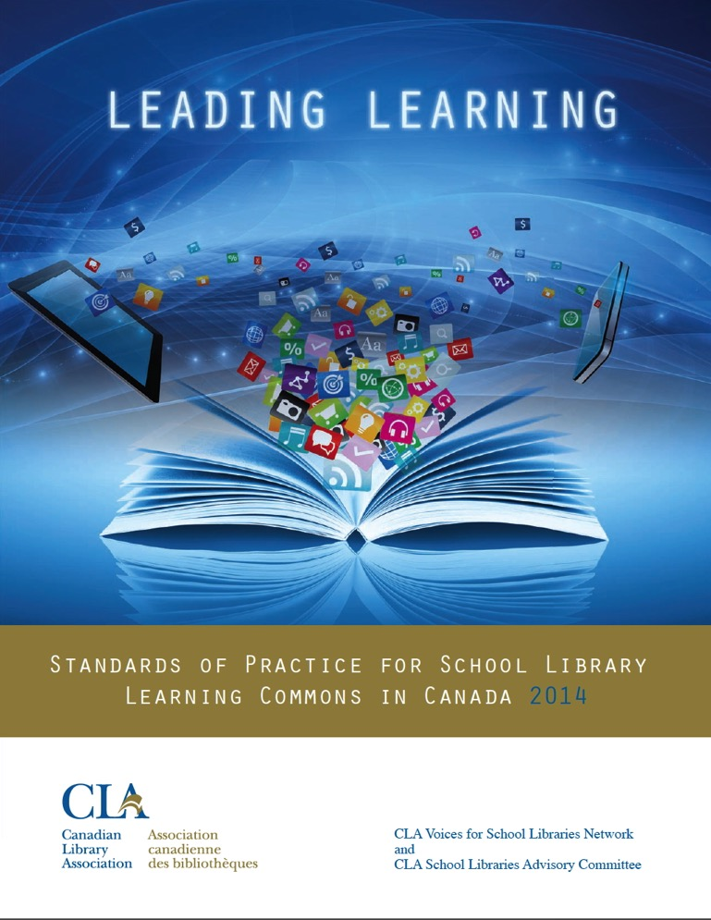

Slide 9
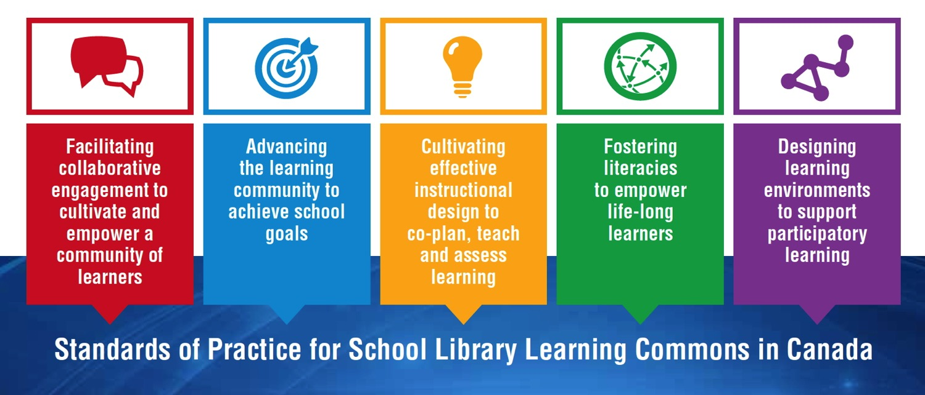
Standards as a Framework for Growth
LEADING LEARNING FRAMEWORK
Standards, Themes and Growth Indicators for School Library Learning Commons

Slide 10
Over to you!
Explore one of the standards.
Summarize the key ideas for the larger group.

Slide 11
Vision for Learning
Design for Collaboration
Partners in Collaborative Learning
Student and Community Partnerships
School Administration Partnerships
District Administration and Consultant
Partnerships
page 11

Slide 12
Planning for School Improvement
Principal Collaborative Role
Teacher-Librarian Collaborative Role
Teacher Collaborative Role
Support Staff Collaborative Role
District Administration and Consultant
Collaborative Role
page 13

Slide 13
Instructional Leadership
Instructional Partnerships
Engaging with Inquiry
Differentiated Learning
Technology for Learning
Assessment for, of and as Learning
Evidence-Based Practice
page 15

Slide 14
Literacy Leadership
Engaging Readers
Information Literacy
Critical Literacy
Digital Literacy and Citizenship
Cultural Literacy
Literacy Partners
page 17

Slide 15
Designing for a Collaborative Physical LLC
Designing for a Collaborative Virtual LLC
Designing for Accessibility in the LLC
Designing for Responsive Print and
Digital Collections
Designing for Creativity and Innovation
Designing for a Participatory School Culture
page 19

Slide 16
The framework of standards comes to life in growth continuums to support transformations from library facilities to vibrant library learning commons. The standards represent guideposts along the journey, and schools will find themselves at different points with each standard and theme within the growth continuums.
Canadian Library Association 2014

Slide 17
Growth Indicators
The goal is to get all schools on the path to providing the very best learning environments and library programs possible to support students academically and personally in learning to learn. Every school will find itself somewhere at a different place on the continuum for each indicator. The continuum will assist decision makers to determine what results have been achieved and also to provide future goals.

Slide 18
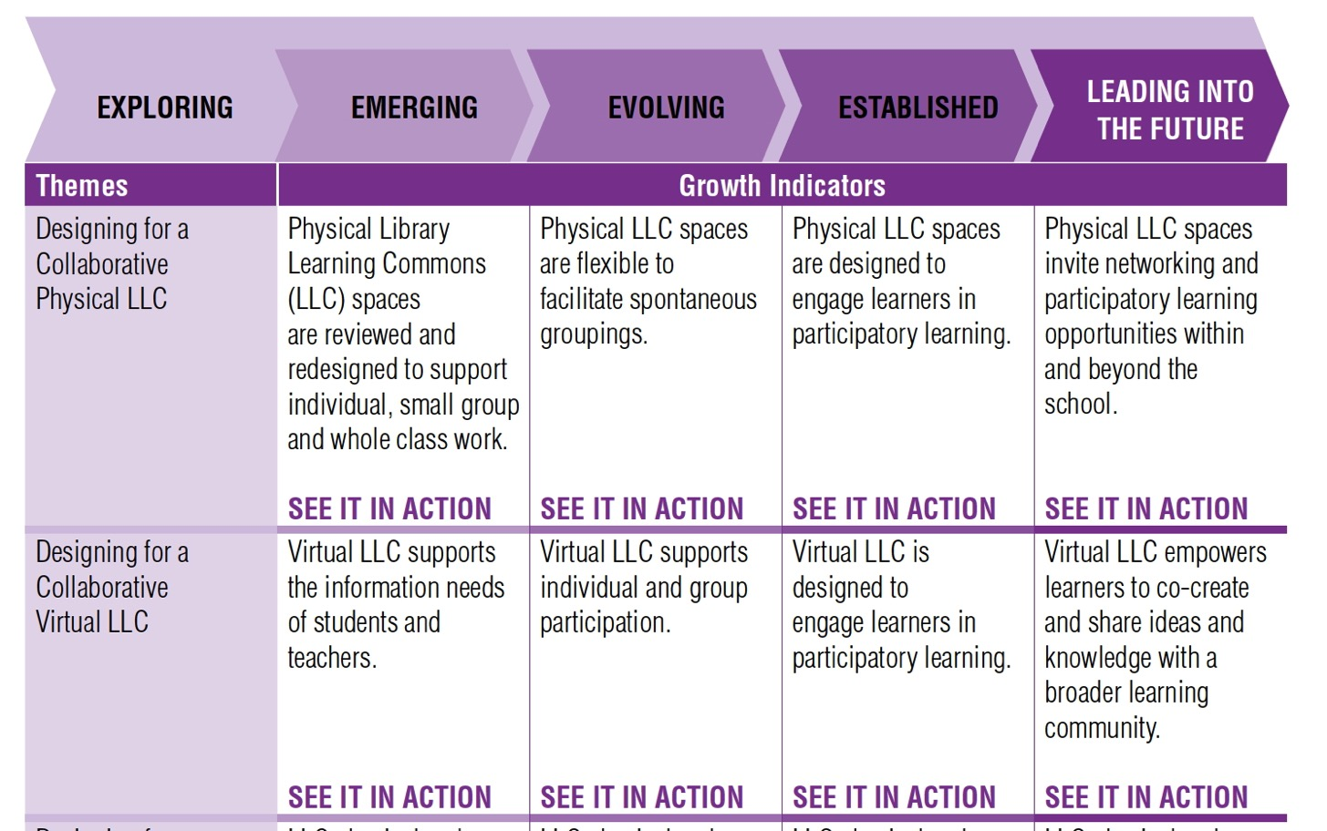
Example: Standard ➔ Themes ➔ Growth Indicators

Slide 19
SEE IT IN ACTION!

Slide 20
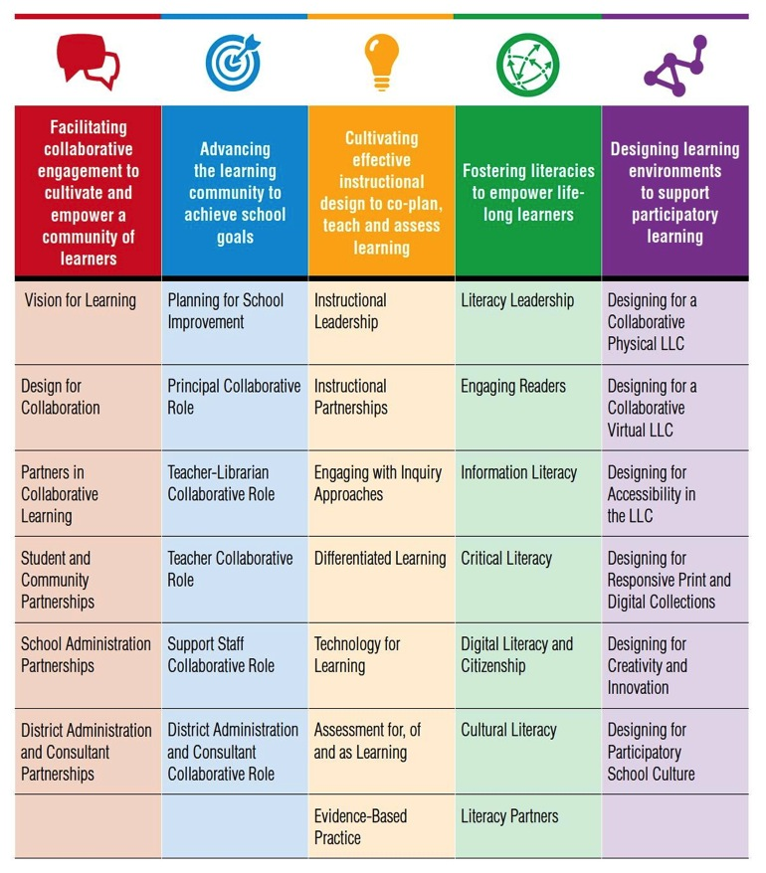
Make the Match: How can Leading Learning help you advance teaching and learning?
Make the
T4L
match!
Make the
BIPSA
match!
Make the
learning cycle match!
Make the
school goals match!
Notes:
Now it’s your turn!
At tables, think about:
Priorities for school libraries in your jurisdiction (ie, T4L in Ontario)
Board improvement plans (BIPSA)
School Goals
Can you find areas on the standards & themes chart that resonate as a priority for you to use Leading Learning to advance teaching and learning? Allow time for table talk.

Slide 21
The Standards: A Whole School Approach
School Library Learning Commons
Physical & Virtual Learning Hub
Drives future-oriented teaching & learning
Inquiry, Problem Based Learning
Reading Thrives
Learning Literacies
Technology for Learning
Critical Thinking, Creativity, Innovation
Engagement with Information & Ideas
Everyone is a learner; everyone is a teacher working collaboratively toward excellence.

