Slide 1
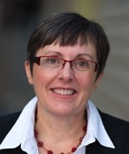
Moving Forward
with your
School Library Learning Commons
Anita Brooks Kirkland
Consultant, Libraries & Learning
www.bythebrooks.ca
Peggy Lunn
Education Library, Teacher Resource Centre Librarian, Queen’s University
http://library.queensu.ca/webtrc/
@AnitaBK

Slide 2
Themes
Designing for a Collaborative Physical LLC
Designing for a Collaborative Virtual LLC
Designing for Accessibility in the LLC
Designing for Responsive Print and Digital Collections
Designing for Creativity and Imagination
Designing for a Participatory School Culture

Slide 3
It’s time for the…
School Library Learning Commons
MAKEOVER CHALLENGE!

Slide 4
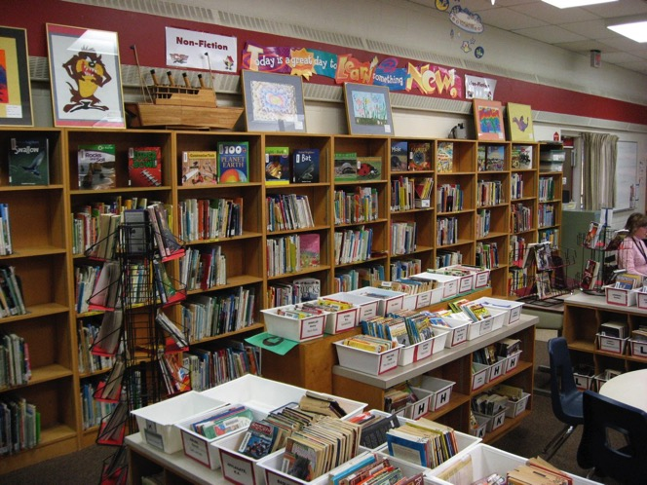
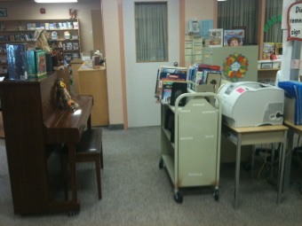
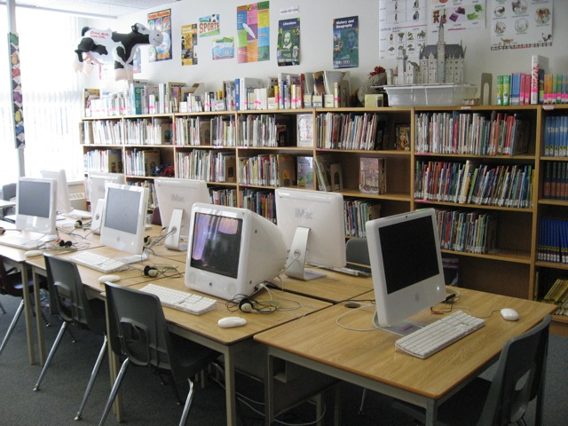

Slide 6
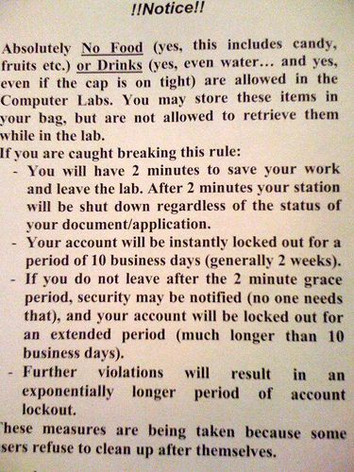
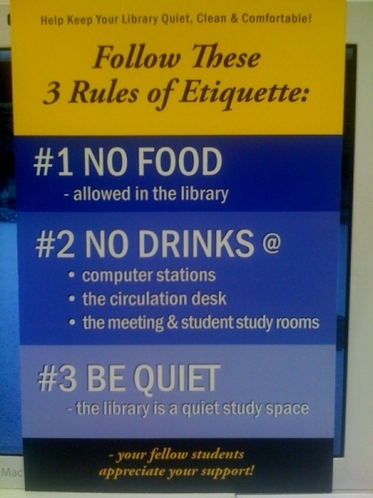
https://www.pinterest.com/anitabk/bad-library-signage/

Slide 7
Image: SlideShare member delcerebro: http://www.slideshare.net/delcerebro/tampa-ux-meetup-october-2014-slides

Slide 8
School Library Learning Commons
MAKEOVER CHALLENGE!
Grab a group / elbow partner and Brainstorm…

Slide 9
What changes can we make to move forward with the Library Learning Commons space?
Physical space?
Virtual space?
Accessibility?
Technology
for learning?
Participatory learning?
Collaboration & creativity?
Print & digital collections for knowledge-building & reading engagement?

Slide 10
Let’s make the connections…
Learning Commons are contemporary
spaces for contemporary learning. It is our goal to see each Learning Commons become an inclusive, flexible, learner-centered, physical and or virtual space for collaboration, inquiry, imagination and play to expand and deepen learning. These centers can accommodate a variety of diverse learning styles, and promote inclusiveness and community in schools.

Slide 11
$$$$ What will it cost?
Complete
Makeover
Moderate
Cost
Minimal
Cost
Almost
Free

Slide 12
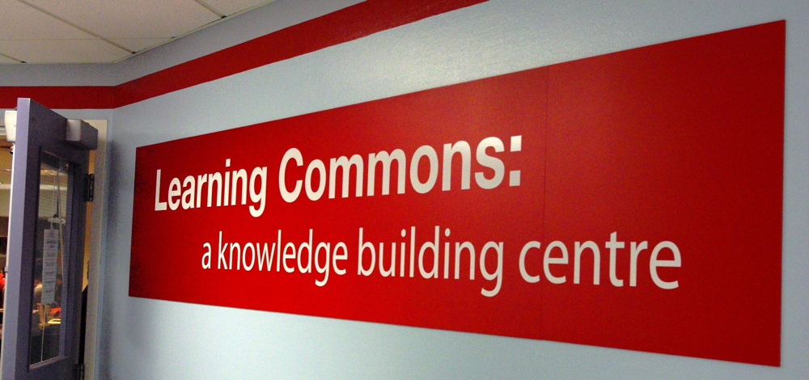
Your transformation may just inspire members of your school community to imagine THEIR library in new ways!

Slide 13
But you
CANNOT
do it
alone!

Slide 14
The Standards: A Whole School Approach
School Library Learning Commons
Physical & Virtual Learning Hub
Drives future-oriented teaching & learning
Inquiry, Problem Based Learning
Reading Thrives
Learning Literacies
Technology for Learning
Critical Thinking, Creativity, Innovation
Engagement with Information & Ideas
Everyone is a learner; everyone is a teacher working collaboratively toward excellence.

Slide 15
Collaborative Leadership Opportunities
Learning Commons Leadership Team
Principal and TL
TL and Teachers
TL and Specialists
TL and Students
Students and Students
TL / LLC Team with Parents and Community
District Level

Slide 16
No teacher-librarian?
It’s even more important to engage teachers in leadership for the learning commons.
Think about leveraging alternative scenarios (LL Appendix 7)

Slide 17
Who will be on your team?
Learning Commons Team
“The Library Learning Commons Leadership Team represents the learning needs of the entire school community.”
page 22-23

Slide 18
The role of the principal
At the school level, the principal is key in establishing and encouraging working partnerships among staff and students. The principal must provide the climate for cooperation, experimentation and growth, The Learning Commons has great potential, but only when everyone participates.
School principals as curriculum leaders and site managers of their schools will provide the leadership, budgets and support for moving forward with library learning commons transitions and implementation of national and regional standards.

Slide 19
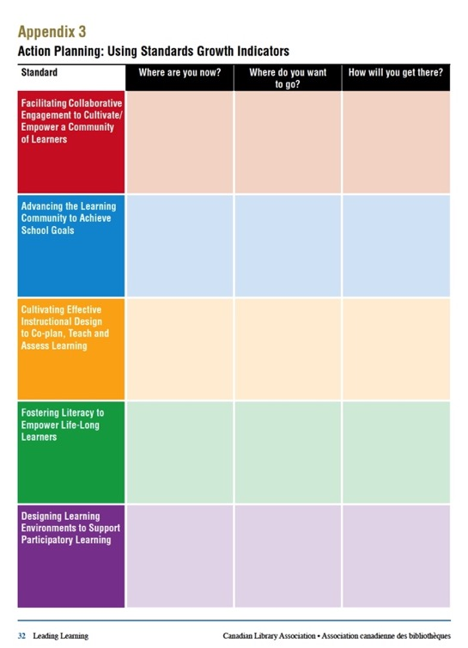
What are your next steps?

Slide 20
What is the potential for the learning commons model to transform learning in the ALCDSB?
School Library Learning Commons
Physical & Virtual Learning Hub
Drives future-oriented teaching & learning
Inquiry, Problem Based Learning
Reading Thrives
Learning Literacies
Technology for Learning
Critical Thinking, Creativity, Innovation
Engagement with Information & Ideas
Discuss…
Share!
Image: https://www.flickr.com/photos/deanhochman/ CC

Slide 21
Opportunities
for
Broader Collaboration
The Library Learning Commons Leadership Team represents the learning needs of the entire school community: teachers, students, community.
Central consultative & technical staff
PLNs
Districts
Associations
Networks

Slide 22
We want you!

Slide 23
www.bythebrooks.ca
www.bythebrooks.ca
➔ Presentations Archives
➔ ALCDSB 2015
http://www.bythebrooks.ca/presentations/presentations-archive/alcdsb-2015/

