Slide 1
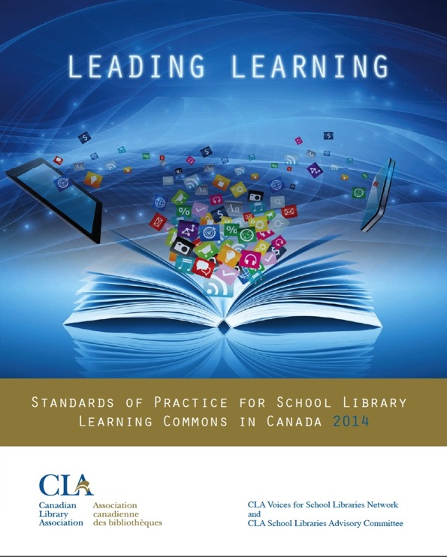
Leading Learning
Standards of Practice for School Library Learning Commons in Canada
Canadian Library Association (2014)
Full PDF document and bibliography available on the School Libraries in Canada website:
http://clatoolbox.ca/casl/slic/llsop.html
Linked from our session webpage

Slide 2
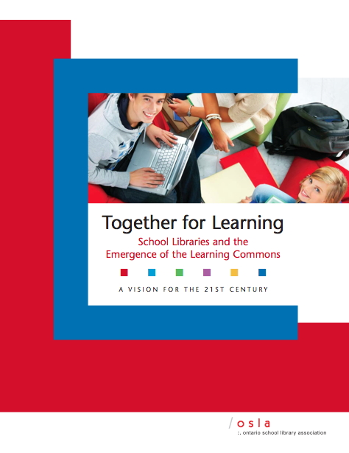
Yes, but how do
we measure our success with these ideas?
Ontario School Library Association, 2010
Funded by Ministry of Education
Ongoing development
www.togetherforlearning.ca

Slide 3
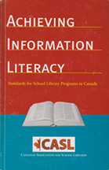
Canadian Library Association
(ATSL & CSLA) 2003
Canadian Library Association 2014
Measuring Outputs
Measuring Impact on Learning

Slide 4
Leading Learning Sets Itself Apart
In the Canadian Context:
Arbitrary and inflexible standards would not be
useful
Unattainable program & staffing models would
disenfranchise many dedicated school library
employees and volunteers
Standards that did not acknowledge the positive
impact of the teacher-librarian would
disenfranchise these dedicated professionals and
defeat the purpose.
Notes:
As a standards document, Leading Learning sets itself apart.
The strong conviction that emerged from the massive collaborative process was that an arbitrary and inflexible set of standards, no matter if they were based on the latest thinking and best research, would not be useful in the Canadian context.
Expectations of seemingly unattainable program and staffing models would disenfranchise many dedicated people who were nevertheless devoted library employees or volunteers.
Standards that did not acknowledge and build on the compelling international research that indicates that the value of the school library is derived from the teacher-librarian (LRC, 2013) would, on the other hand, disenfranchise this dedicated profession and defeat the overall purpose.

Slide 5
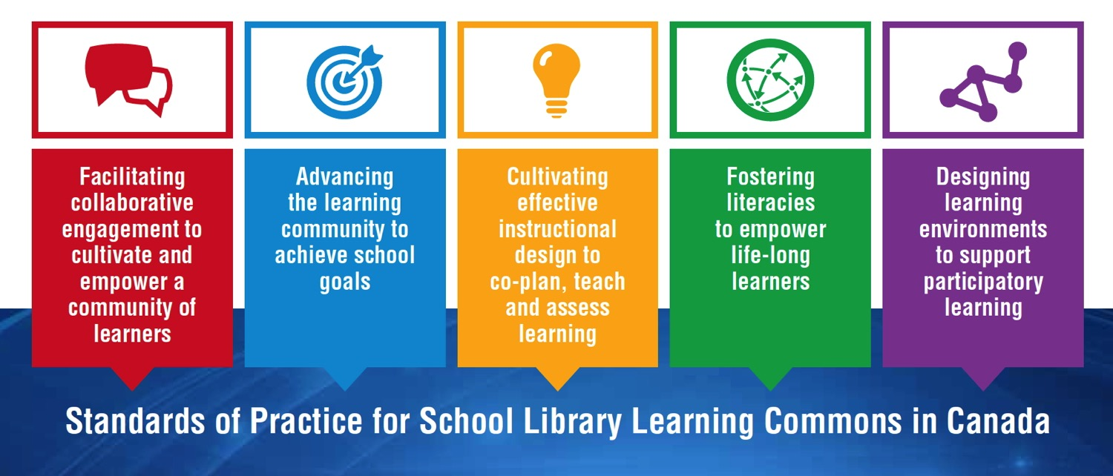
Standards as a Framework for Growth
LEADING LEARNING FRAMEWORK
Standards, Themes and Growth Indicators for School Library Learning Commons

Slide 6
Vision for Learning
Design for Collaboration
Partners in Collaborative Learning
Student and Community Partnerships
School Administration Partnerships
District Administration and Consultant
Partnerships
page 11

Slide 7
Planning for School Improvement
Principal Collaborative Role
Teacher-Librarian Collaborative Role
Teacher Collaborative Role
Support Staff Collaborative Role
District Administration and Consultant
Collaborative Role
page 13

Slide 8
Instructional Leadership
Instructional Partnerships
Engaging with Inquiry
Differentiated Learning
Technology for Learning
Assessment for, of and as Learning
Evidence-Based Practice
page 15

Slide 9
Literacy Leadership
Engaging Readers
Information Literacy
Critical Literacy
Digital Literacy and Citizenship
Cultural Literacy
Literacy Partners
page 17

Slide 10
Designing for a Collaborative Physical LLC
Designing for a Collaborative Virtual LLC
Designing for Accessibility in the LLC
Designing for Responsive Print and
Digital Collections
Designing for Creativity and Innovation
Designing for a Participatory School Culture
page 19

Slide 11
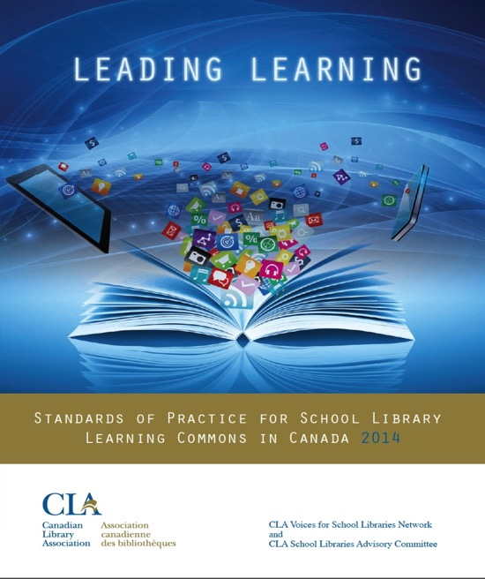
The framework of standards comes to life in growth continuums to support transformations from library facilities to vibrant library learning commons. The standards represent guideposts along the journey, and schools will find themselves at different points with each standard and theme within the growth continuums.
Canadian Library Association 2014

Slide 12
Growth Indicators
The goal is to get all schools on the path to providing the very best learning environments and library programs possible to support students academically and personally in learning to learn. Every school will find itself somewhere at a different place on the continuum for each indicator. The continuum will assist decision makers to determine what results have been achieved and also to provide future goals.

Slide 13
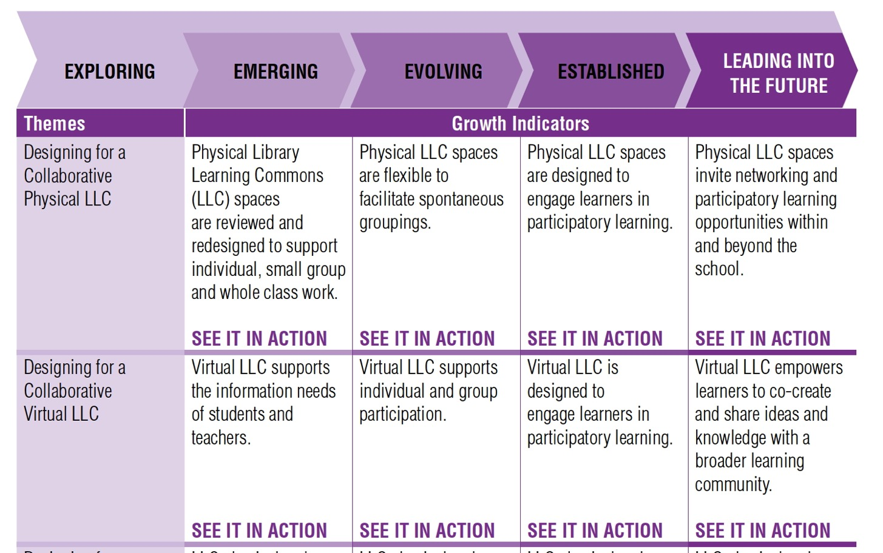
Example: Standard ➔ Themes ➔ Growth Indicators

Slide 14
SEE IT IN ACTION!

Slide 15
The Standards: A Whole School Approach
School Library Learning Commons
Physical & Virtual Learning Hub
Drives future-oriented teaching & learning
Inquiry, Problem Based Learning
Reading Thrives
Learning Literacies
Technology for Learning
Critical Thinking, Creativity, Innovation
Engagement with Information & Ideas
Everyone is a learner; everyone is a teacher working collaboratively toward excellence.

