Slide 1

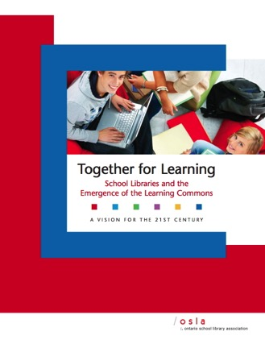



Your Library Learning Commons
Anita Brooks Kirkland
Consultant, Libraries & Learning
www.bythebrooks.ca
Peggy Lunn
Education Library, Teacher Resource Centre Librarian, Queen’s University
http://library.queensu.ca/webtrc/
@AnitaBK

Slide 2
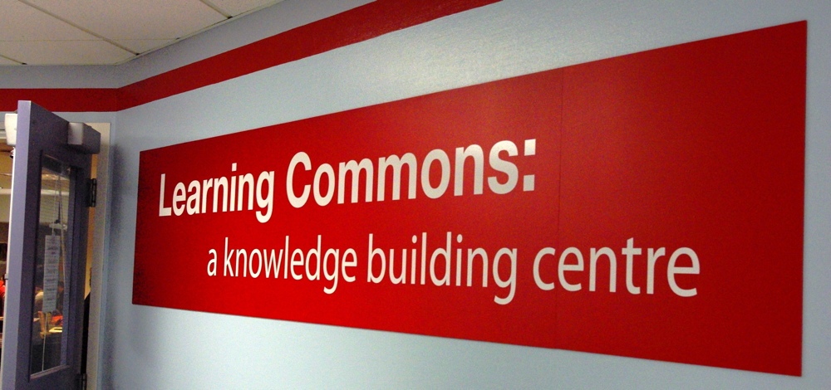
What is a Learning Commons?

Slide 3
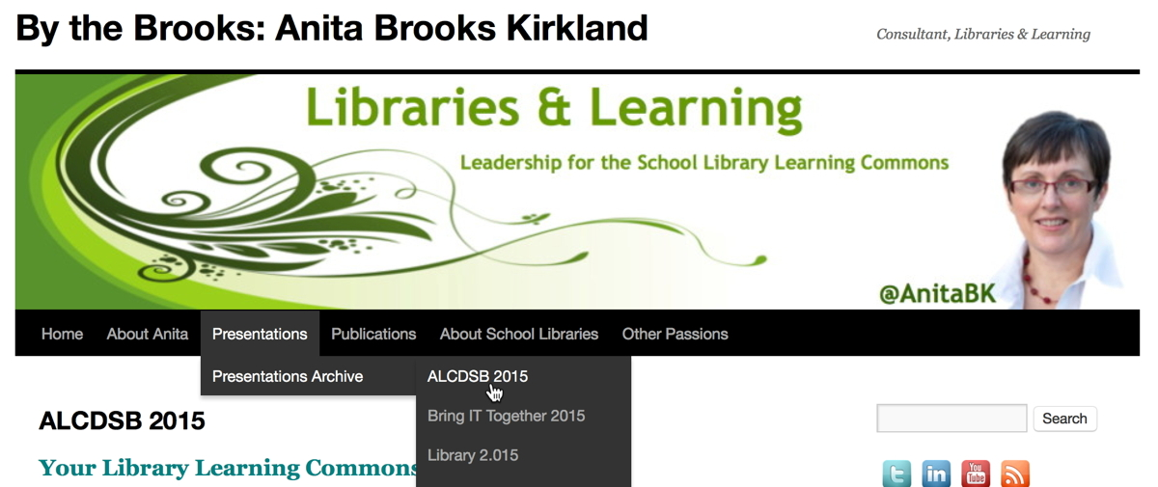
www.bythebrooks.ca
www.bythebrooks.ca
➔ Presentations Archives
➔ ALCDSB 2015
http://www.bythebrooks.ca/presentations/presentations-archive/alcdsb-2015/

Slide 4

MINDS ON…
How would YOU
describe the concept of the learning commons?
Image: Public Domain

Slide 5
VISION: The Algonquin and Lakeshore
Catholic District School Board is committed to transforming its current library structures into open and flexible learning spaces that share print and digital resources, while promoting a culture of collaboration, creativity, critical thinking and inquiry.

Slide 6


June 21, 2010
Knowledge in Crisis!
Cited by David Weinberger in the prologue to Too Big To Know (2011)

Slide 7

Employability Skills 2000+
Fundamental Skills
Communicate
Manage Information
Use Numbers
Think and Solve Problems
Personal Management Skills
Demonstrate Positive Attitudes and Behaviours
Be Responsible
Be Adaptable
Learn Continuously
Work Safely
Teamwork Skills
Work With Others
Participate in Projects and Tasks
http://www.conferenceboard.ca/topics/education/learning-tools/employability-skills.aspx

Slide 8

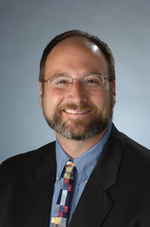
The mission of a library is to improve society through facilitating knowledge creation in the community.
Good libraries build services (and the collection is one of many). Great libraries build communities.
Expect More: Demanding Better Libraries for Today’s Complex World.
R. David Lankes (2012).

Slide 9

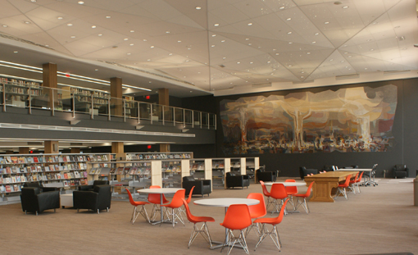
“A place for community partnerships and personal connections.”
“Our library brings the world to all of our citizens.”
The library as a “public living room”.
Photo: www.kpl.org
http://www.bythebrooks.ca/kitchener-public-library-grand-re-opening/

Slide 10
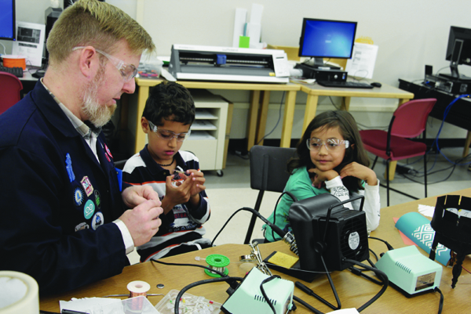

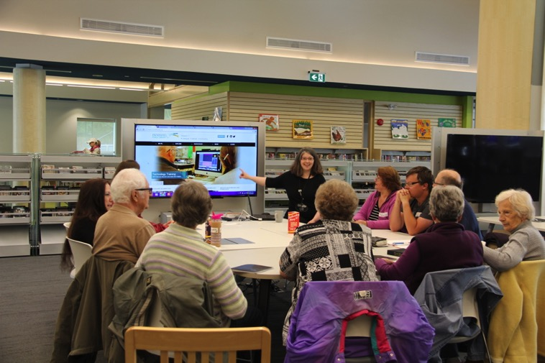
Maker Space
Photo:http://americanlibrariesmagazine.org/2014/02/26/making-room-for-informal-learning/
Appy Hour
Photo: http://www.innisfil.library.on.ca/appy-hour-0

Slide 11
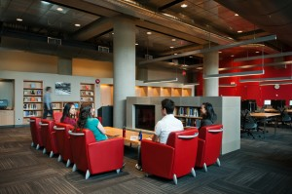

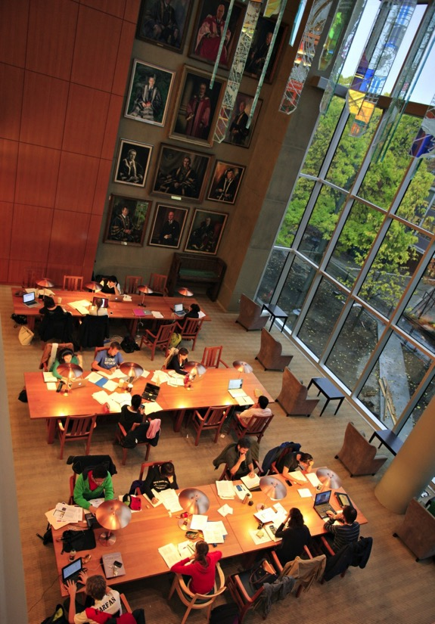
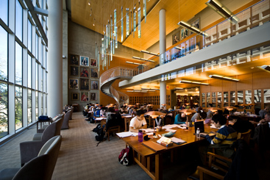
Photo: http://about.library.ubc.ca/2013/12/19/ubc-library-update-cpsld-newsletter-fall-2013/
Photo: http://www.macleans.ca/education/university/campus-life-at-the-university-of-british-columbia/
Photo: http://about.library.ubc.ca/2013/09/18/visit-ubc-librarys-standout-spots/

Slide 12
Today’s schools are being asked to shift from teaching a body of facts and formulas to teaching inquiry and process. What better place to support students in learning through process than a library, whose basic mission is the process of finding and making sense of knowledge?
Expect More: Demanding Better Libraries for Today’s Complex World.
R. David Lankes (2012).

Slide 13
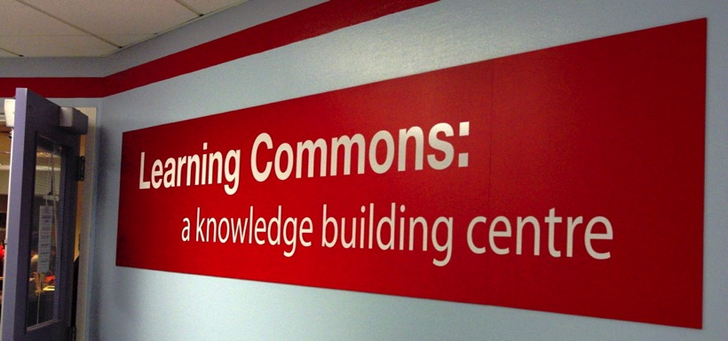
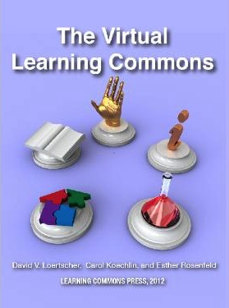
A Learning Commons is a common or shared space that is both physical and virtual. It is designed to move students beyond mere research, practice and group work to a greater level of engagement through exploration, experimentation, and collaboration.
Claremont Secondary School Learning Commons. Photo by Carol Nahachewsky:https://onlineacademiccommunity.uvic.ca/caroln/2013/10/30/library-to-learning-commons-reflections-on-a-visit-to-the-claremont-learning-commons/
The Virtual Learning Commons
Loertscher, Koechlin & Rosenfeld (2012).

Slide 14
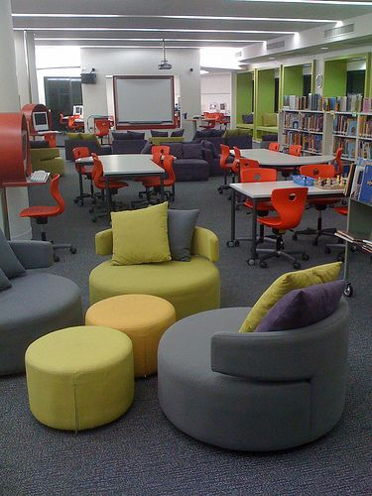
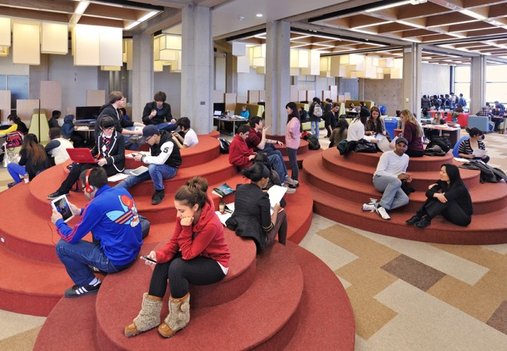
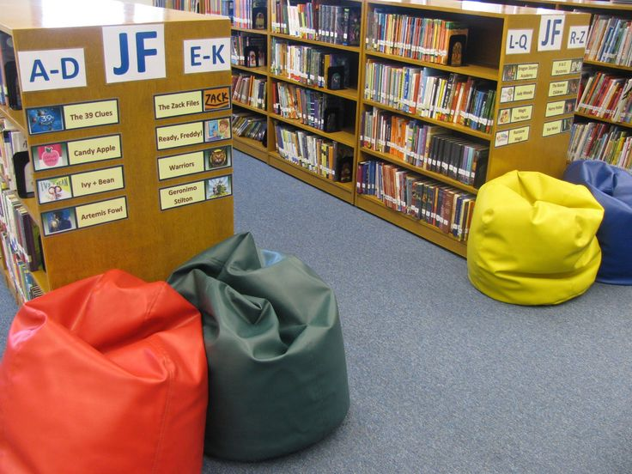
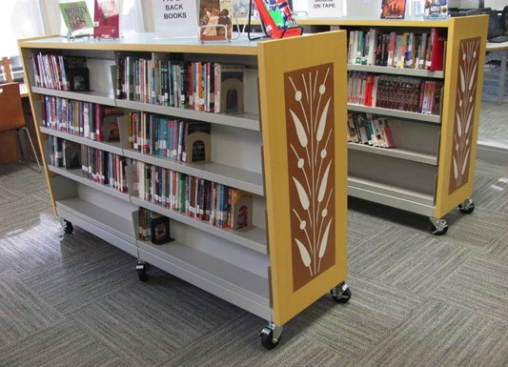
Photo: http://www.nomeancity.net/york-learning-commons-by-levitt-goodman-architects/
Photo: http://mscofino.edublogs.org/category/the-learning-hub/
Photo: http://creativelibraryconcepts.com/roll-it-over-mobile-shelving-helps-libraries-to-open-up-space/
Photo: http://4.bp.blogspot.com/-GTA0Z1G1ius/TnRYuC3xywI/AAAAAAAAACg/BYzi5p1PfWA/s1600/IMG_5371.JPG

Slide 15
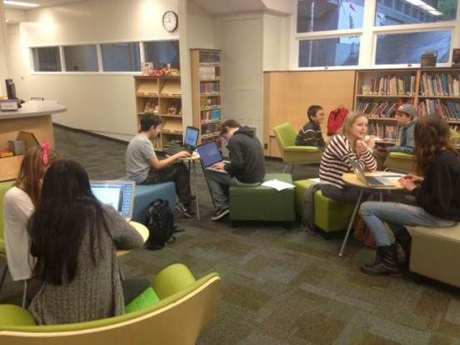
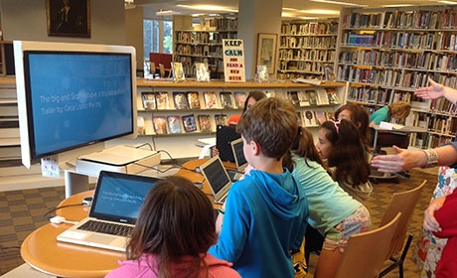
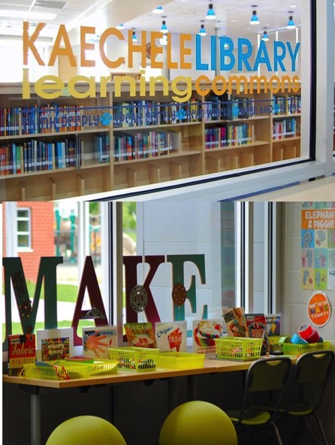
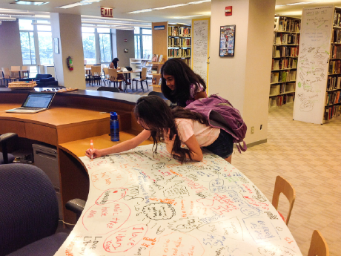

Photo: http://cultureofyes.ca/2015/02/12/the-learning-commons-mindset/
Photo: http://www.edutopia.org/blog/21st-century-libraries-learning-commons-beth-holland
Photo: http://www.edutopia.org/blog/21st-century-libraries-learning-commons-
beth-holland
www.pinterest.com/anitabk/
Photo: http://tinkerlab.com/maker-space-library-learning-commons/

Slide 16
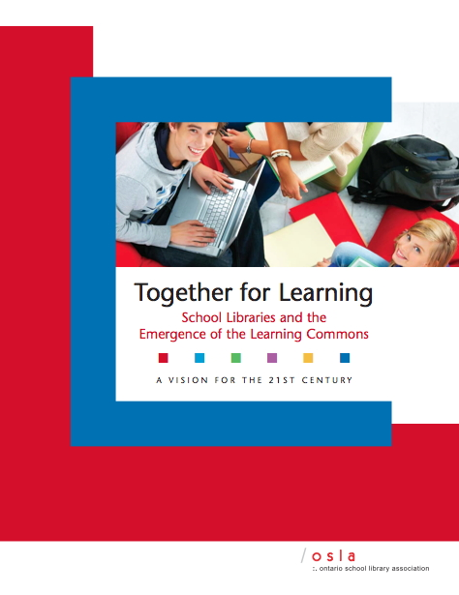
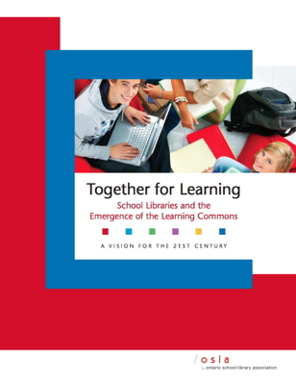
The Learning Commons liberates the exploration of ideas and concepts, encouraging inquiry, imagination, discovery and creativity through the connection of learners to information, to each other and to communities around the world.
A whole school approach
Library provides the natural dynamics for developing a learning commons

Slide 17
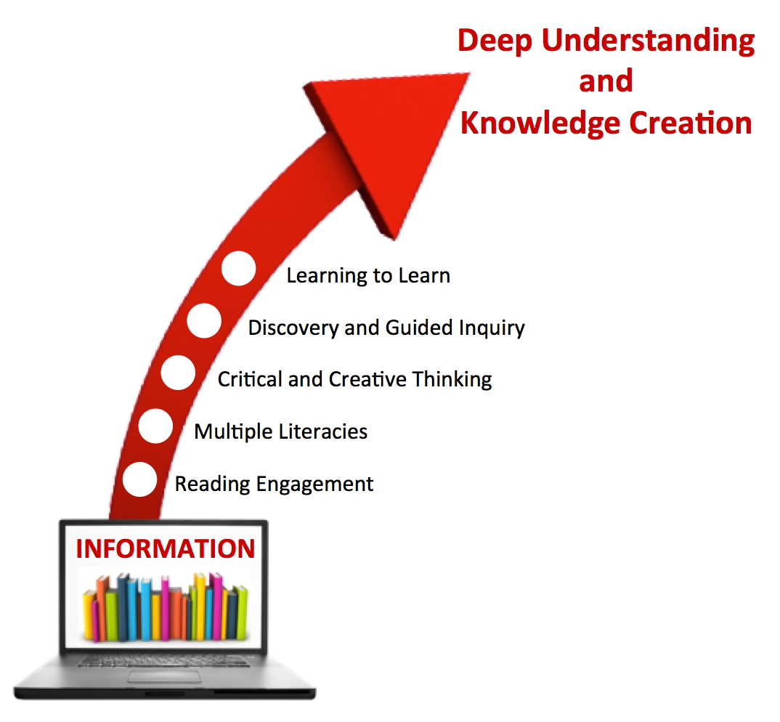

Learning
To
Learn
Seeing everyone as a learner is at the crux of the Learning Commons.

Slide 18

What is a Library Learning Commons?
School Library Learning Commons
Physical & Virtual Learning Hub
Drives future-oriented teaching & learning
Inquiry, Problem Based Learning
Reading Thrives
Learning Literacies
Technology for Learning
Critical Thinking, Creativity, Innovation
Engagement with Information & Ideas
Everyone is a learner; everyone is a teacher working collaboratively toward excellence.

