Slide 1
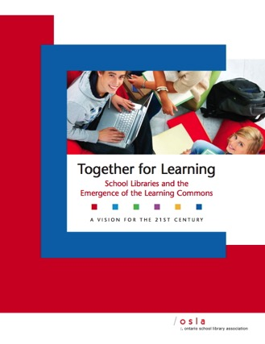
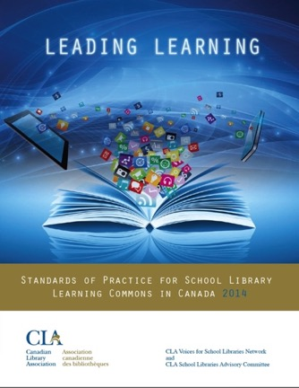
Year of the Learning Commons
Jeanne Conte
Instructional Coordinator / Educational Librarian, Peel District School Board
Anita Brooks Kirkland
Consultant, Libraries & Learning
www.bythebrooks.ca
@contej
@AnitaBK

Slide 2
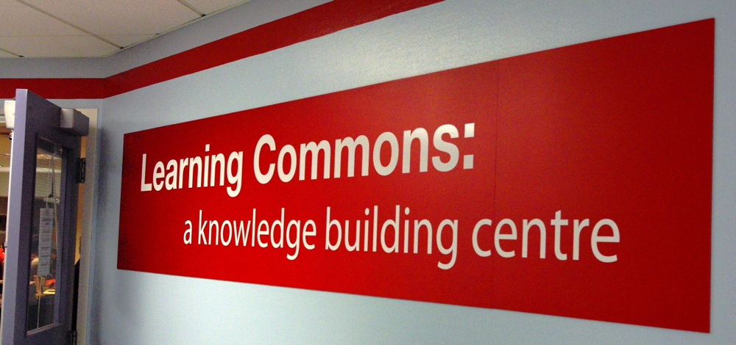
What is a Learning Commons?

Slide 3
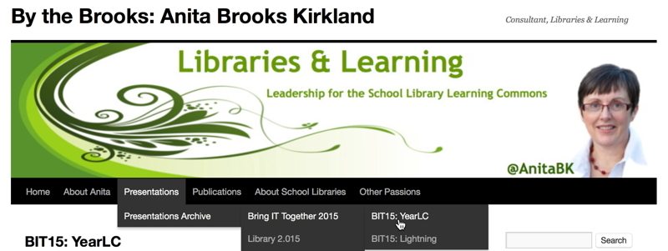
www.bythebrooks.ca/bit15-yearlc
www.bythebrooks.ca
➔ Presentations Archives
➔ Bring IT Together 2015
➔ BIT15: YearLC

Slide 4
MINDS ON…
How would YOU
describe the concept of the learning commons?
Find the link at: www.bythebrooks.ca/bit15-yearlc

Slide 5
June 21, 2010
Knowledge in Crisis!
Cited by David Weinberger in the prologue to Too Big To Know (2011)

Slide 6
Employability Skills 2000+
Fundamental Skills
Communicate
Manage Information
Use Numbers
Think and Solve Problems
Personal Management Skills
Demonstrate Positive Attitudes and Behaviours
Be Responsible
Be Adaptable
Learn Continuously
Work Safely
Teamwork Skills
Work With Others
Participate in Projects and Tasks
http://www.conferenceboard.ca/topics/education/learning-tools/employability-skills.aspx

Slide 7
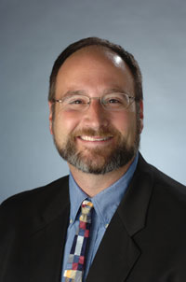
The mission of a library is to improve society through facilitating knowledge creation in the community.
Good libraries build services (and the collection is one of many). Great libraries build communities.
Expect More: Demanding Better Libraries for Today’s Complex World.
R. David Lankes (2012).

Slide 8
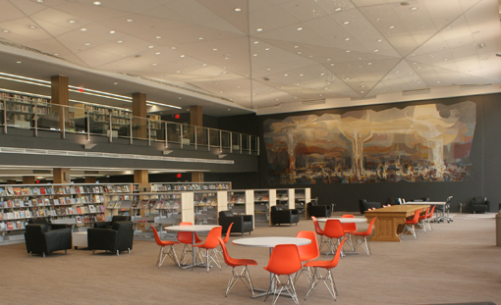
“A place for community partnerships and personal connections.”
“Our library brings the world to all of our citizens.”
The library as a “public living room”.
Photo: www.kpl.org
http://www.bythebrooks.ca/kitchener-public-library-grand-re-opening/

Slide 9
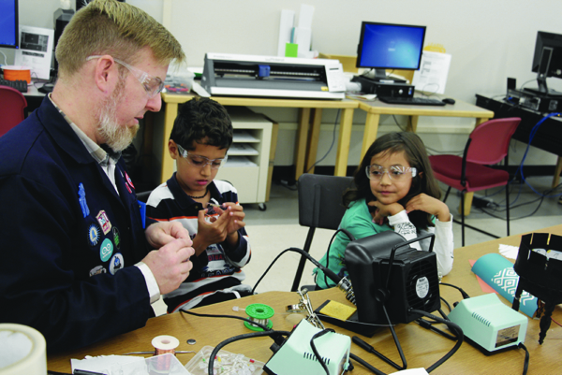
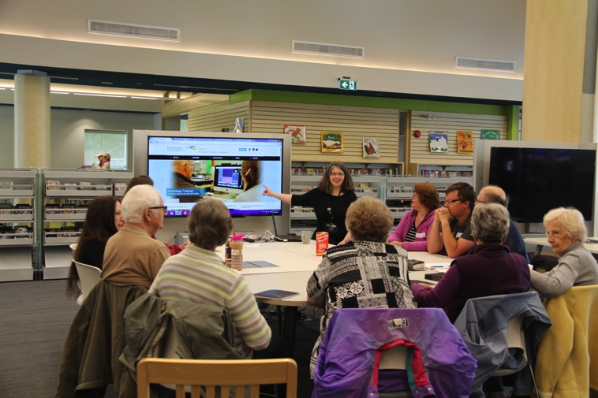
Maker Space
Photo:http://americanlibrariesmagazine.org/2014/02/26/making-room-for-informal-learning/
Appy Hour
Photo: http://www.innisfil.library.on.ca/appy-hour-0

Slide 10
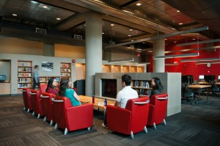
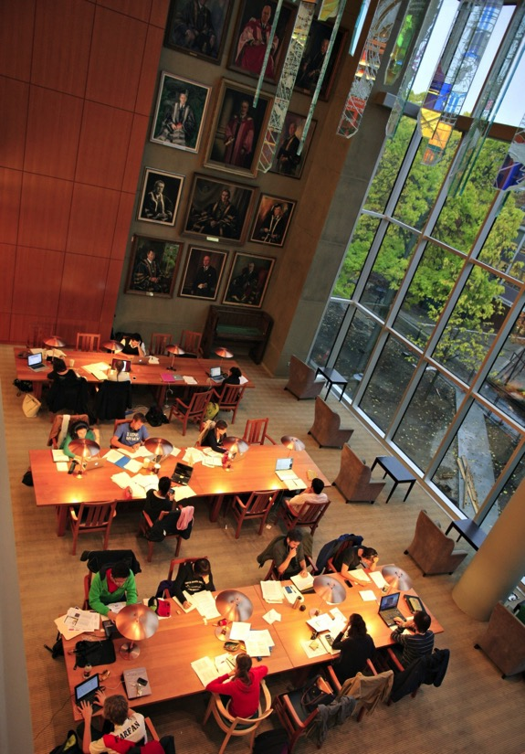
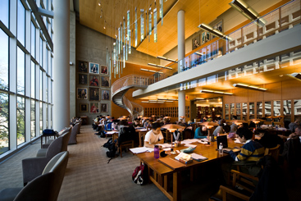
Photo: http://about.library.ubc.ca/2013/12/19/ubc-library-update-cpsld-newsletter-fall-2013/
Photo: http://www.macleans.ca/education/university/campus-life-at-the-university-of-british-columbia/
Photo: http://about.library.ubc.ca/2013/09/18/visit-ubc-librarys-standout-spots/

Slide 11
Today’s schools are being asked to shift from teaching a body of facts and formulas to teaching inquiry and process. What better place to support students in learning through process than a library, whose basic mission is the process of finding and making sense of knowledge?
Expect More: Demanding Better Libraries for Today’s Complex World.
R. David Lankes (2012).

Slide 12
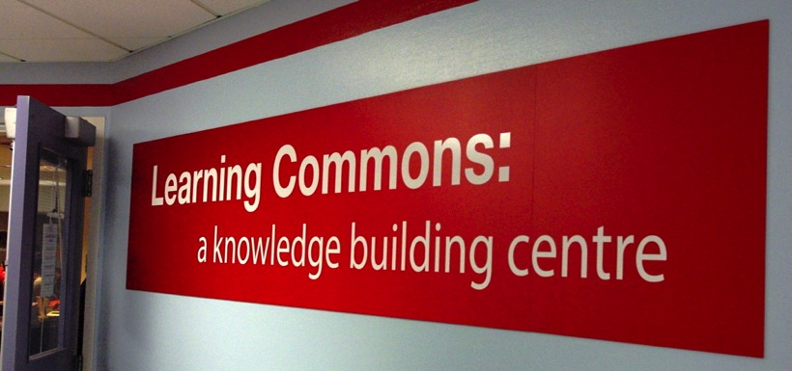
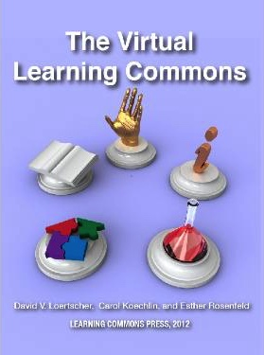
A Learning Commons is a common or shared space that is both physical and virtual. It is designed to move students beyond mere research, practice and group work to a greater level of engagement through exploration, experimentation, and collaboration.
Claremont Secondary School Learning Commons. Photo by Carol Nahachewsky:https://onlineacademiccommunity.uvic.ca/caroln/2013/10/30/library-to-learning-commons-reflections-on-a-visit-to-the-claremont-learning-commons/
The Virtual Learning Commons
Loertscher, Koechlin & Rosenfeld (2012).

Slide 13
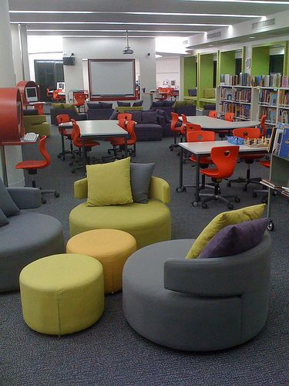
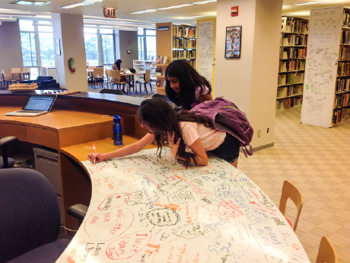
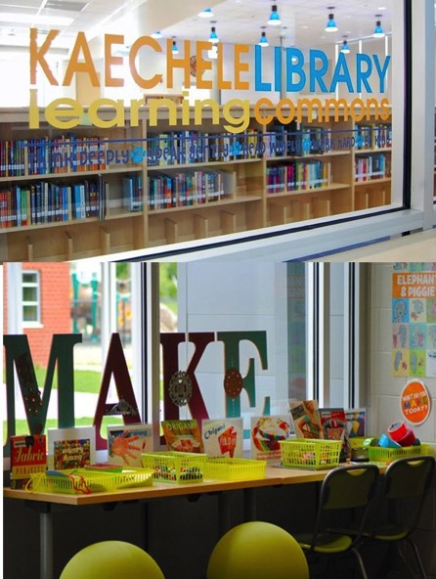
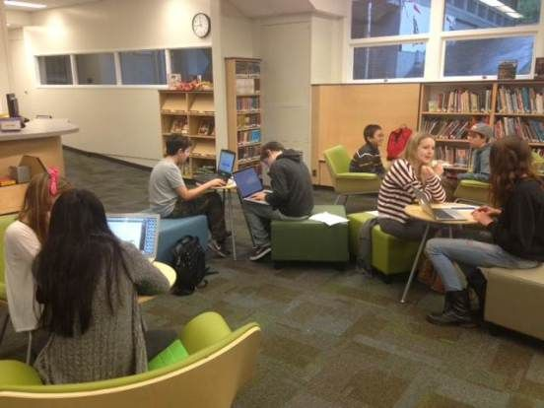
Photo: http://www.edutopia.org/blog/21st-century-libraries-learning-commons-
beth-holland
Photo: http://mscofino.edublogs.org/category/the-learning-hub/
Photo: http://cultureofyes.ca/2015/02/12/the-learning-commons-mindset/
Photo: http://tinkerlab.com/maker-space-library-learning-commons/

Slide 14
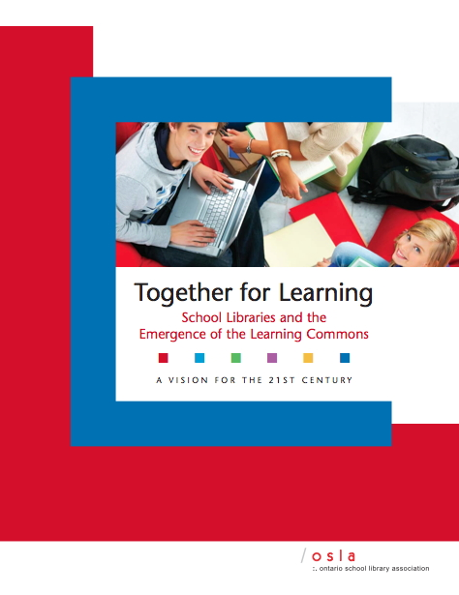
The Learning Commons liberates the exploration of ideas and concepts, encouraging inquiry, imagination, discovery and creativity through the connection of learners to information, to each other and to communities around the world.

Slide 15
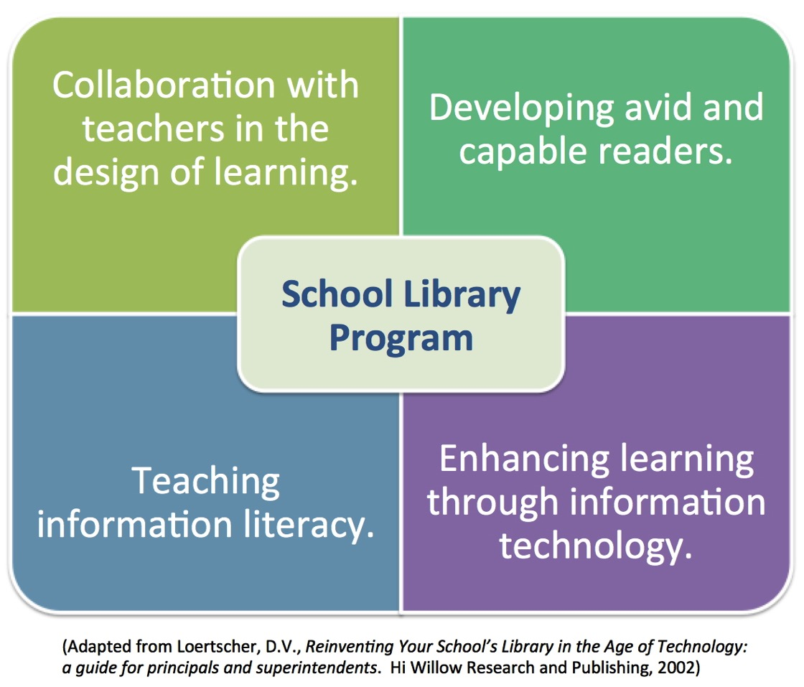
Loertscher’s Cornerstones of the School Library Program

Slide 16
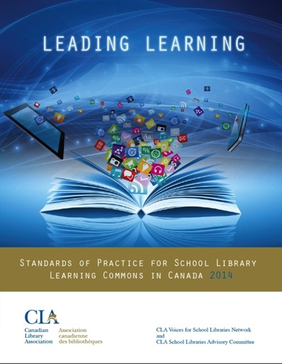
What is a Library Learning Commons?
School Library Learning Commons
Physical & Virtual Learning Hub
Drives future-oriented teaching & learning
Inquiry, Problem Based Learning
Reading Thrives
Learning Literacies
Technology for Learning
Critical Thinking, Creativity, Innovation
Engagement with Information & Ideas
Everyone is a learner; everyone is a teacher working collaboratively toward excellence.

Slide 17
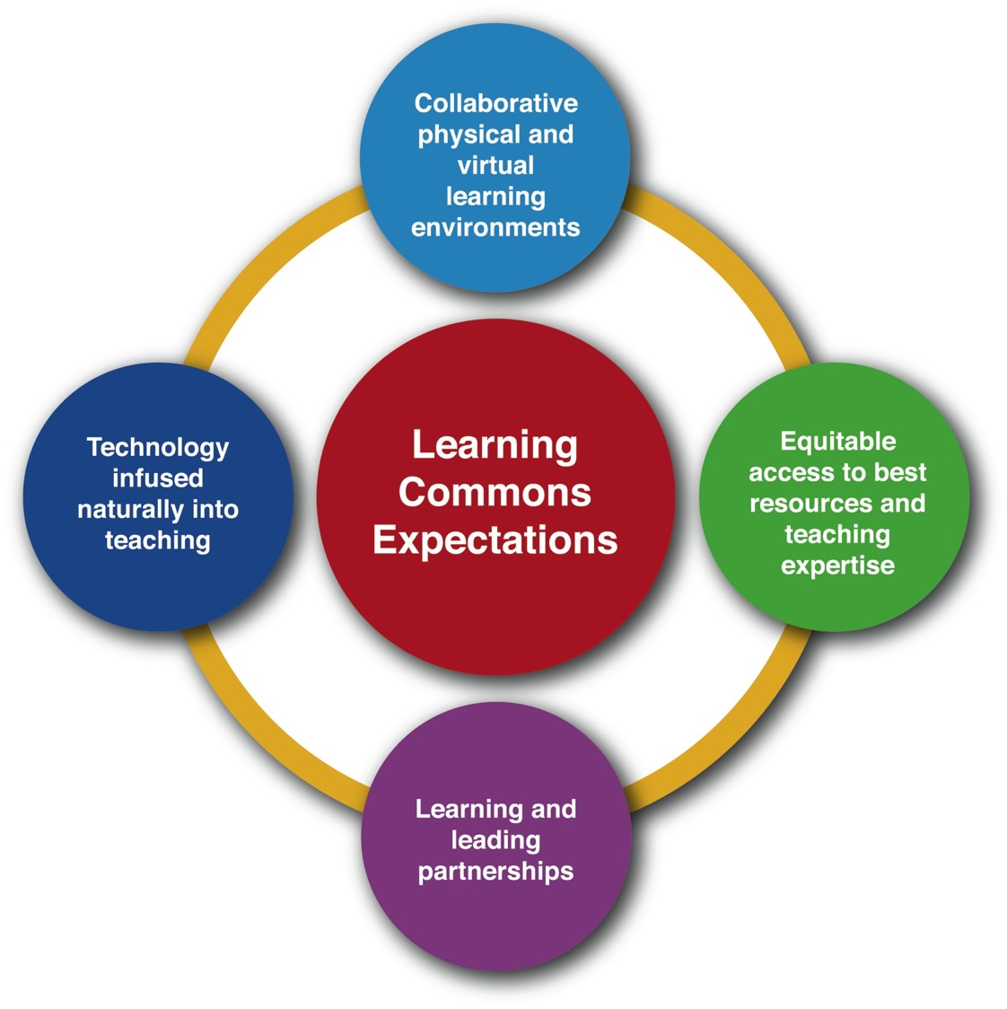
What is a Library Learning Commons?

Slide 18
Learning
To
Learn
Seeing everyone as a learner is at the crux of the Learning Commons.

Slide 19
Collaboration
Community
Within a Learning Commons, new relationships are formed between learners, new technologies are realized and utilized, and both students and educators prepare for the future as they learn new ways to learn.
Creativity
Co-Learning

