Slide 1
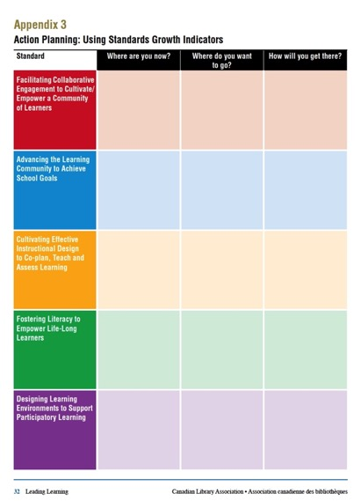
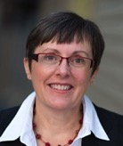
Collaborative Leadership in the Learning Commons
Part 3: Moving Forward with Your SLLC
www.bythebrooks.ca
Anita Brooks Kirkland
Consultant, Libraries & Learning
@AnitaBK

Slide 2
Goals and Aspirations
Strategic Alignment

Slide 3
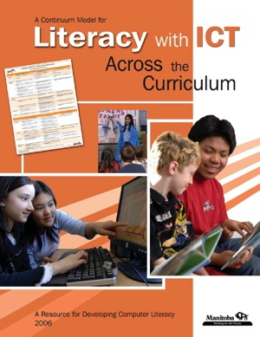

Slide 4
Carol Ridd
Consultant for the Arts & Library Programming, RETSD
How does “Leading Learning” fit with RETSD’s Priorities and 21st Century Belief Statements?
Expectations for Student Learning
All students in RETSD will be personally and intellectually engaged in their learning at school.
By the end of Grade 8, all students in RETSD will meet the provincial curricular standards in literacy and numeracy, allowing them the greatest possibility for success in high school.
Individuals excel where there are high expectations and challenging learning opportunities.
Everyone is unique and can achieve success.

Slide 5
Leading Learning BINGO!
Make the MANITOBA MATCH!

Slide 6
What should be the next steps at your school?
What are realistic and relevant goals?
Where are you now, and where can you move on the continuum?
Who should be on your school’s Learning Commons Leadership Team?

Slide 7
No teacher-librarian?
It’s even more important to engage teachers in leadership for the learning commons.
Think about leveraging alternative scenarios (LL Appendix 7)

Slide 8
How will you engage, as the principal?
At the school level, the principal is key in establishing and encouraging working partnerships among staff and students. The principal must provide the climate for cooperation, experimentation and growth, The Learning Commons has great potential, but only when everyone participates.
School principals as curriculum leaders and site managers of their schools will provide the leadership, budgets and support for moving forward with library learning commons transitions and implementation of national and regional standards.

Slide 9
Division-Wide Collaboration: RETSD Virtual Library
School Website
Welcome to our school library Lending Policies
Staff Program
Library Hours

Slide 10
The Big Think
What opportunities can the River East Transcona School Division Pursue to support consistent development
of School Library Learning Commons
across all schools?

Slide 11
How can you collaborate to build a vibrant virtual library?
How can you collaborate to foster professional learning?
How can you collaborate to measure and celebrate success?

Slide 13
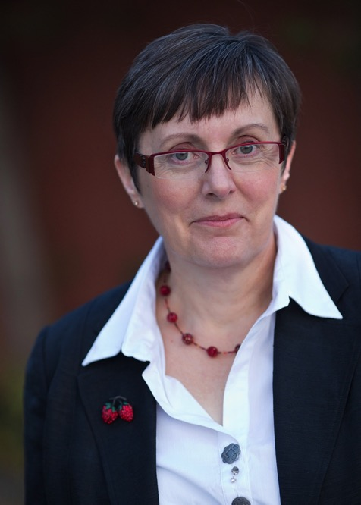
Collaborative Leadership in the Learning Commons
Thank you, and best wishes!
www.bythebrooks.ca
@AnitaBK
anitabk@bythebrooks.ca
Anita Brooks Kirkland

