Slide 1
Collaborative Leadership in the Learning Commons
Part 2: Leading Learning with the SLLC
www.bythebrooks.ca
Anita Brooks Kirkland
Consultant, Libraries & Learning
@AnitaBK

Slide 2
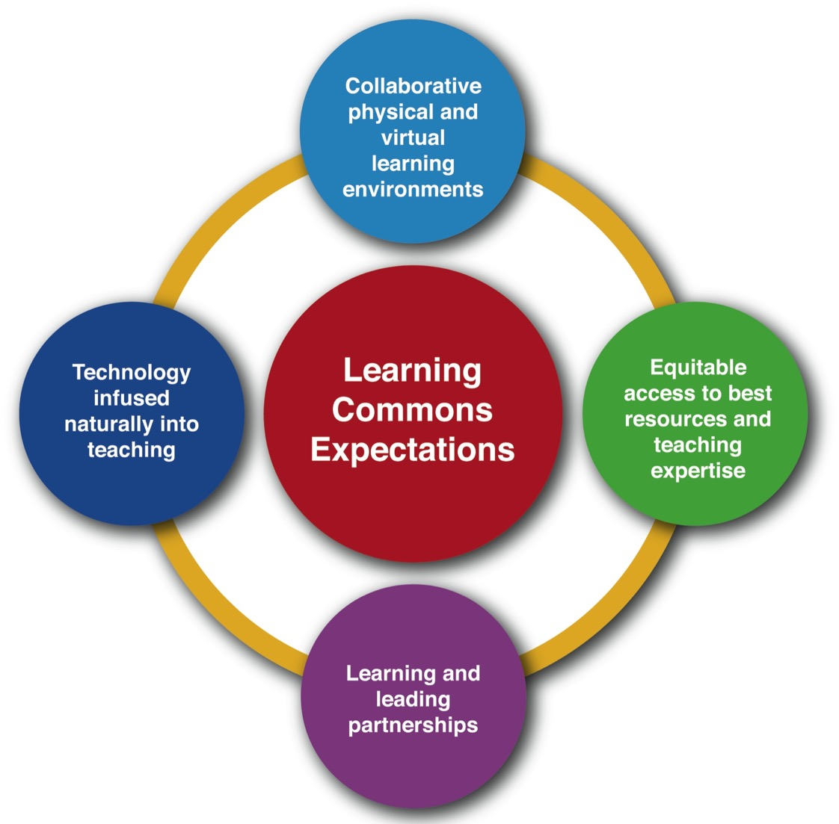

Slide 4
Yes, but how do
we measure our success with these ideas?

Slide 5
Canadian Library Association
(ATSL & CSLA) 2003
Canadian Library Association 2014
Measuring Outputs
Measuring Impact on Learning

Slide 6
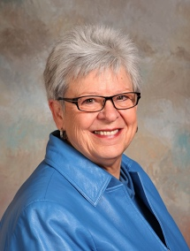
Evaluation provides the
data needed to ensure that the school library program and, in particular, the teacher-librarian are indeed relentlessly focused on learning.
Diane Oberg
Oberg (2014): Relentlessly Focused on Learning: The Role of Evaluation
https://sites.google.com/site/treasuremountaincanada3/advancing-the-learning-community/oberg

Slide 8
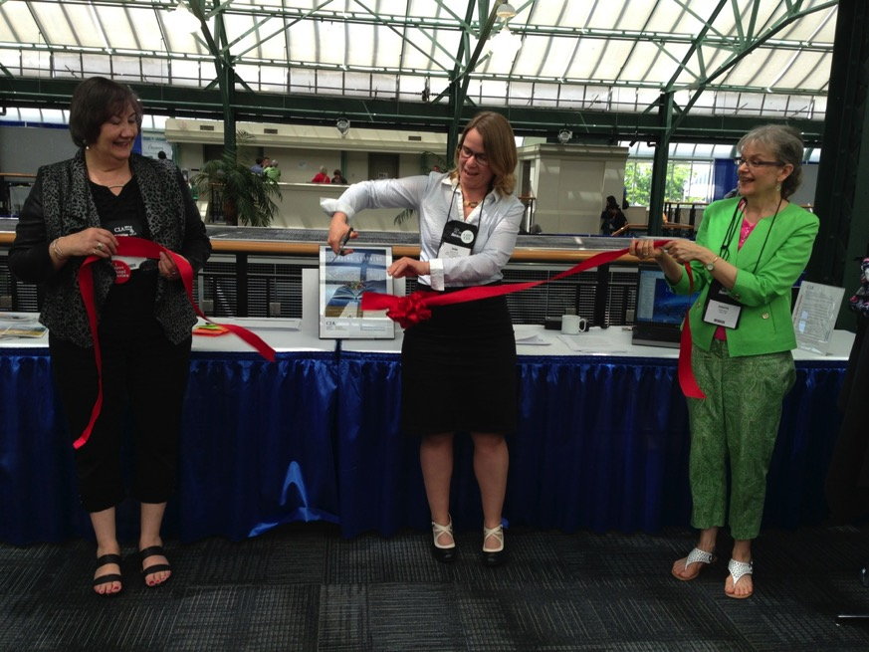
A Grand National Collaboration
Input from school library practitioners, other educators and stakeholders from every province and territory in Canada.
Linda Shantz-Keresztes, Jane Schmidt & Judith Sykes
Carol Koechlin

Slide 9
Making a Difference
Alberta Education endorses Leading Learning as a resource for 2014 Learning Commons Policy: many using LL to frame professional learning around standards.
Alberta
British Columbia
Alignment with OSLA’s Together for Learning. Major school districts implement program evaluations and frame professional learning around Leading Learning.
Alignment with BCTLA’s From Library to Learning Commons
Ontario
Québec School Librarians Network (QSLiN) creates online digital badging PD modules for Leading Learning
Winnipeg school districts run full day PD event around transforming practice with Leading Learning.
Manitoba
Québec

Slide 10
The Standards: A Whole School Approach
School Library Learning Commons
Physical & Virtual Learning Hub
Drives future-oriented teaching & learning
Inquiry, Problem Based Learning
Reading Thrives
Learning Literacies
Technology for Learning
Critical Thinking, Creativity, Innovation
Engagement with Information & Ideas
Everyone is a learner; everyone is a teacher working collaboratively toward excellence.

Slide 11
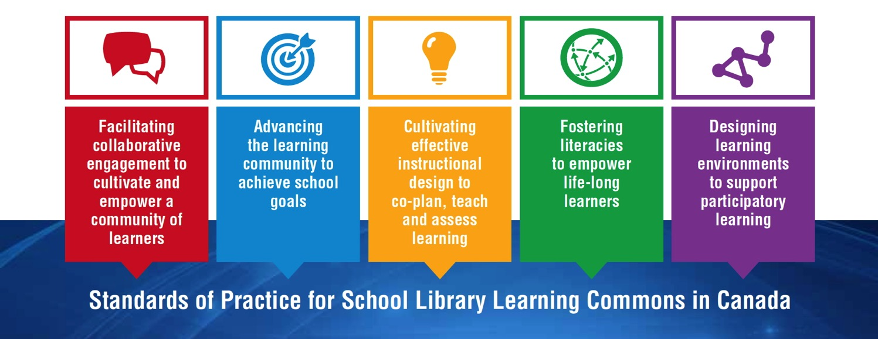
How are standards expressed to be “relentlessly focused on learning”?

Slide 12
NON-HIERARCHICAL!

Slide 13
The framework of standards comes to life in growth continuums to support transformations from library facilities to vibrant library learning commons. The standards represent guideposts along the journey, and schools will find themselves at different points with each standard and theme within the growth continuums.
Canadian Library Association 2014

Slide 14
Growth Indicators
The goal is to get all schools on the path to providing the very best learning environments and library programs possible to support students academically and personally in learning to learn. Every school will find itself somewhere at a different place on the continuum for each indicator. The continuum will assist decision makers to determine what results have been achieved and also to provide future goals.

Slide 15
Over to you!
Explore one of the standards.
Summarize the key ideas for the larger group.

Slide 16
Themes
Vision for Learning
Design for Collaboration
Partners in Collaborative Learning
Student and Community Partnerships
School Administration Partnerships
District Administration and Consultant Partnerships

Slide 17
Themes
Planning for School Improvement
Principal Collaborative Role
Teacher-Librarian Collaborative Role
Teacher Collaborative Role
Support Staff Collaborative Role
District Administration and Consultant Collaborative Role

Slide 18
Themes
Instructional Leadership
Instructional Partnerships
Engaging with Inquiry Approaches
Differentiated Learning
Technology for Learning
Assessment for, of and as Learning
Evidence-Based Practice

Slide 19
Themes
Literacy Leadership
Engaging Readers
Information Literacy
Critical Literacy
Digital Literacy and Citizenship
Cultural Literacy
Literacy Partners

Slide 20
Themes
Designing for a Collaborative Physical LLC
Designing for a Collaborative Virtual LLC
Designing for Accessibility in the LLC
Designing for Responsive Print and Digital Collections
Designing for Creativity and Imagination
Designing for a Participatory School Culture

Slide 21
Full PDF document and bibliography available on the School Libraries in Canada website:
http://clatoolbox.ca/casl/slic/llsop.html

Slide 22
SEE IT IN ACTION!

Slide 24
The role of the principal
At the school level, the principal is key in establishing and encouraging working partnerships among staff and students. The principal must provide the climate for cooperation, experimentation and growth, The Learning Commons has great potential, but only when everyone participates.
School principals as curriculum leaders and site managers of their schools will provide the leadership, budgets and support for moving forward with library learning commons transitions and implementation of national and regional standards.

Slide 25
The Library Learning Commons Leadership Team represents the learning needs of the entire school community: teachers, students, community.
Central consultative & technical staff
PLNs
Districts
Associations
Networks
A Collaborative Team Approach

