Slide 1
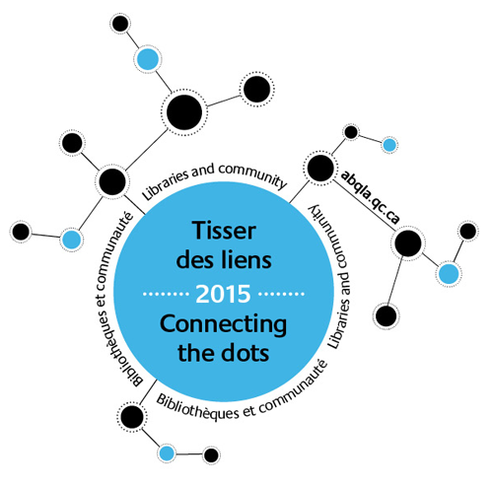
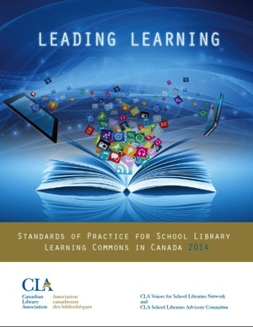
to Transform School Libraries
Anita Brooks Kirkland
www.bythebrooks.ca
Consultant, Libraries & Learning
Past-President (2014), Ontario Library Association
@AnitaBK

Slide 2
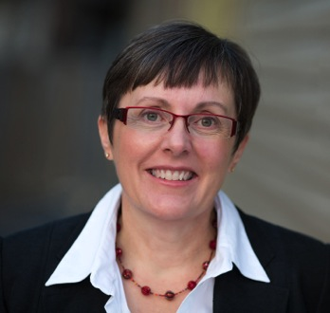
Libraries
School
Post-Secondary
Special
Public
School
What library sector do you work in?
What do we all have in common?

Slide 3
Libraries
School
Post-Secondary
Special
Public
Under this view of a library ecosystem, all types of libraries work together to deliver learning opportunities for people of all ages.
We all deserve the right to libraries and must understand that, when one part of the ecosystem is under threat, we all pay the price.
Barbara K. Stripling, ALA President 2014. Our Library Ecosystem is Under Threat
Huffington Post, April 16, 2014

Slide 4
Libraries
School
Post-Secondary
Special
Public

Slide 6
What do we mean by
Library Learning Commons?

Slide 7
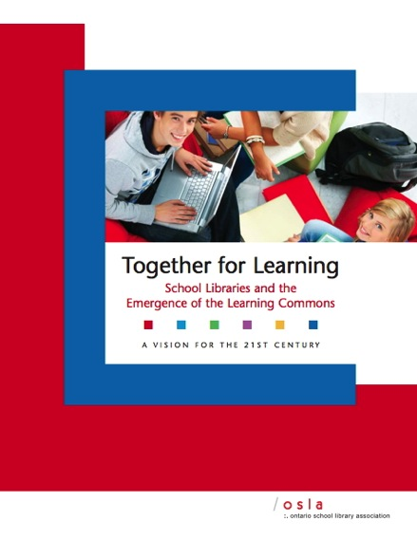
There is a growing consensus among educators that students need to learn transferable skills in order to work efficiently and successfully in our future world.
Critical consumers of information
Effective problem-solvers
Capable decision-makers
Innovative communicators
Ontario School Library Association (2010)

Slide 8
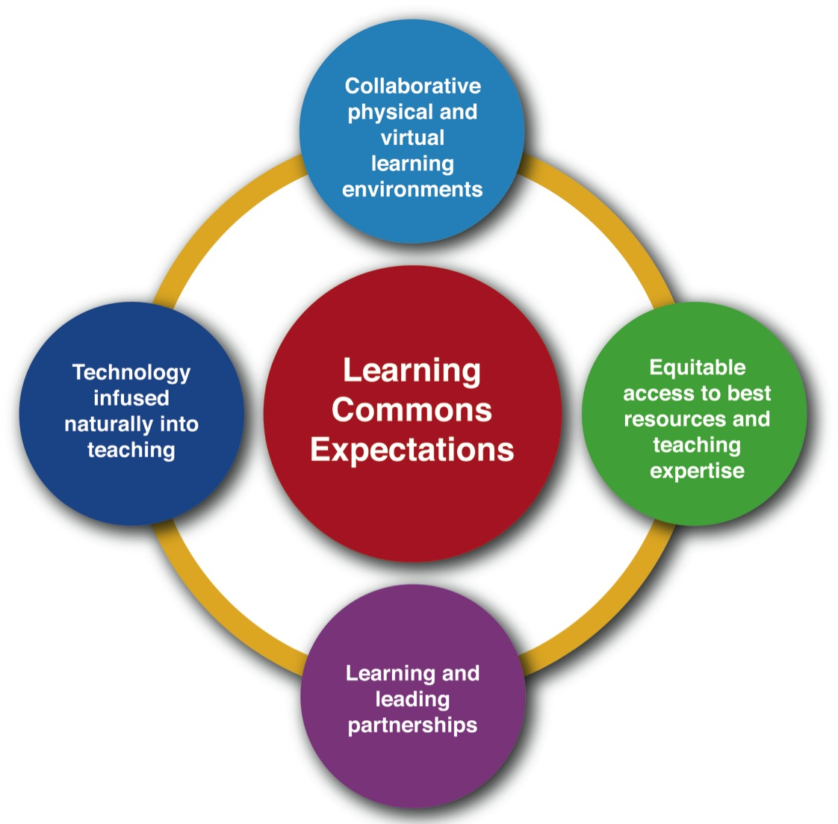

Slide 10
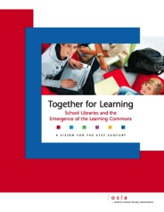
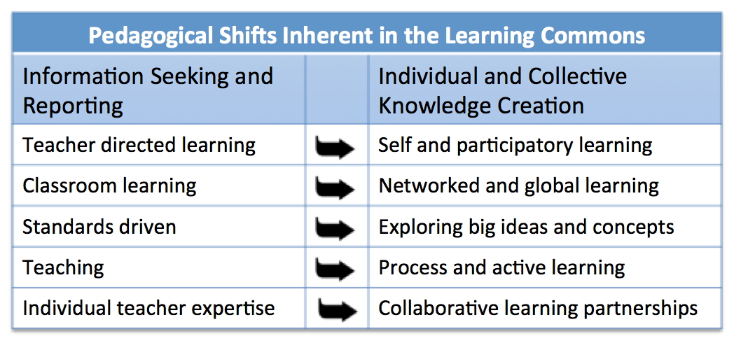

Slide 11
What is a Library Learning Commons?
A learning commons is a whole school approach to building a participatory learning community. The library learning commons is the physical and virtual collaborative learning hub of the school. It is designed to engineer and drive future-oriented learning and teaching throughout the entire school. Inquiry, project/problem-based learning experiences are designed as catalysts for intellectual engagement with information, ideas, thinking, and dialogue. Reading thrives, learning literacies and technology competencies evolve, and critical thinking, creativity, innovation and playing to learn are nourished. Everyone is a learner; everyone is a teacher working collaboratively toward excellence.
Leading Learning: Standards of Practice for School Library Learning Commons in Canada (2014)

Slide 12
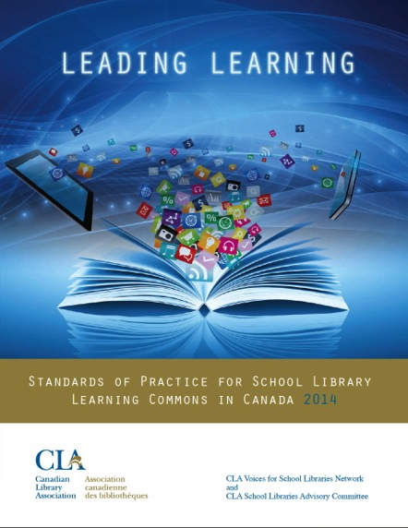
What is a Library Learning Commons?
Whole school approach
Participatory learning community
Physical and virtual collaborative learning
Drives future-oriented learning & teaching
Inquiry, project/problem-based learning:
Reading
Learning literacies
Technology competencies
Critical thinking
Creativity
Innovation
Playing to learn
Everyone is a learner, everyone is a teacher
Working collaboratively toward excellence

Slide 13
Learners have a right to expect good school libraries in every school in Canada. Our school libraries should reflect our common values of equity, diversity, and cultural identity as well as best approaches in the educational and library professions. They should be contextually relevant to student need and success, and built, cared for, measured, renewed and sustained on an ongoing basis by their learning communities. We should position school libraries to lead learning for the future.

Slide 14
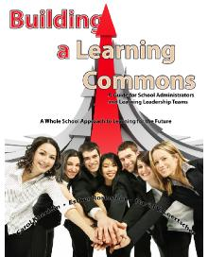
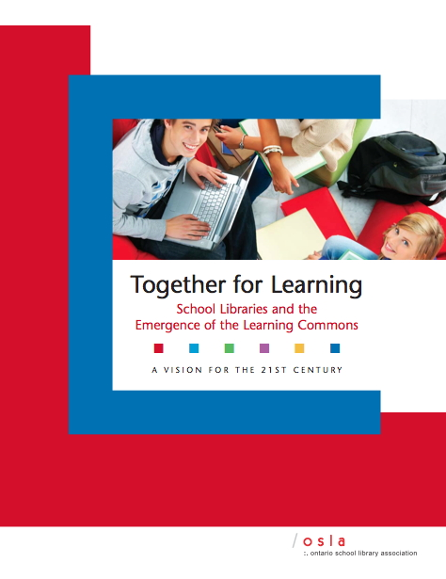
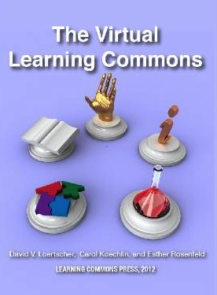
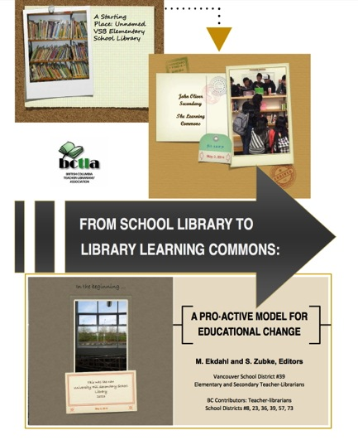

Slide 15
Vision Document
Framework for Growth

Slide 16
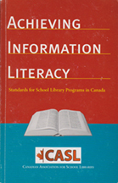
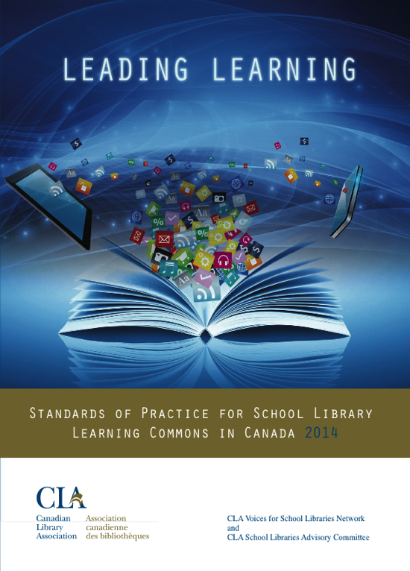
How did the journey begin?
Notes:
The purpose of the new standards project was to provide to those responsible for and committed to viable and successful school libraries in Canada, measures and standards. In preparation, library leaders and practitioners across Canada contributed to “Treasure Mountain II” 2012, a research retreat informing the project. These links and other resources informing the project are all on the national project site. Hyperlinked to first photo
In 2003 the Canadian Library Association supported and published Achieving Information Literacy, Standards for School Library Programs in Canada, reprinted in 2006, and available to download on School Libraries in Canada (SLIC) site where the new standards also reside.
The new standards are not a revision of Achieving Information Literacy, a seminal reference on its own, but are a new digital format focused on changing landscapes in education and the entire library community.
(SLIC site hyperlinked with both standards).

Slide 17
A Model of Participatory Knowledge Building
CLA School Library Advisory Committee
CLA Voices for Schools Libraries Network
Project Steering Committees
Project Focus Group

Slide 18
Provincial/Territorial Committees – formed January 2013
British Columbia Teacher-Librarian Association (BCTLA)
Alberta School Library Association (ASLC)
Saskatchewan School Library Association (SSLA)
Manitoba School Library Association (MSLA)
Ontario School Library Association (OSLA)
Quebec Association pour la promotion des services
documentaires scolaires (APSDS)
Nova Scotia (Regional Libraries and School Boards)
New Brunswick (Regional Libraries and School Boards)
Newfoundland and Labrador Teacher-Librarian Association (NLTLA)
Prince Edward Island Teacher-Librarian Association (PEITLA)
Yukon Teacher-Librarians’ Sub-Association (YTLS-A)
Northwest Territories (Schools)
Nunavut (Schools)
Notes:
This project has been developed through provincial/territorial school library associations in the formation of volunteer committees that as much as possible represented an ideal “school library learning commons team” e.g. teacher-librarian or lead teacher, principal, library technician, classroom teachers, parents, possibly students, and community librarians or other community representatives.
We are very thankful for the support of the Canadian Library Association, which has enabled our provincial/territorial committees to come together to bring a national presence to school libraries in Canada which we hope to continue.

Slide 19
https://sites.google.com/site/nationalslproject/

Slide 21
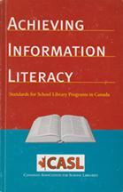
Canadian Library Association
(ATSL & CSLA) 2003
Canadian Library Association 2014
Measuring Outputs
Measuring Impact on Learning

Slide 22
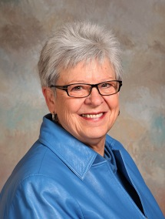
Evaluation provides the
data needed to ensure that the school library program and, in particular, the teacher-librarian are indeed relentlessly focused on learning.
Diane Oberg
Oberg (2014): Relentlessly Focused on Learning: The Role of Evaluation
https://sites.google.com/site/treasuremountaincanada3/advancing-the-learning-community/oberg

Slide 23
Introduction
What is the reality in Canada?
Why a Learning Commons now?
What will this document do to help your school get started?
The time
to reinvest
is now!

Slide 24
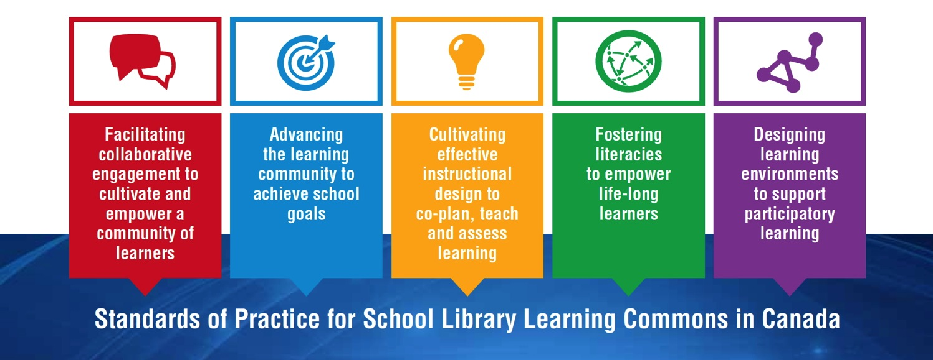
LEADING LEARNING FRAMEWORK
Standards, Themes and Growth Indicators for School Library Learning Commons

Slide 26
Standards
Themes
See page 10

Slide 27
See page 8
How are standards expressed to be “relentlessly focused on learning”?

Slide 28
NON-HIERARCHICAL!

Slide 29
Growth Indicators
See page 8 - 9
The goal is to get all schools on the path to providing the very best learning environments and library programs possible to support students academically and personally in learning to learn. Every school will find itself somewhere at a different place on the continuum for each indicator. The continuum will assist decision makers to determine what results have been achieved and also to provide future goals.

Slide 30
The framework of standards comes to life in growth continuums to support transformations from library facilities to vibrant library learning commons. The standards represent guideposts along the journey, and schools will find themselves at different points with each standard and theme within the growth continuums.
Canadian Library Association 2014
See page 6

Slide 31
Theme
Growth Indicator
Example
(Hyperlinked in PDF)

Slide 32
See it in Action! Each Growth Indicator is Illustrated
Live link to Canadian example.

Slide 34
Over to you!
Explore one of the standards.
Anything that:
Surprises?
Resonates?
Affirms?

Slide 35
Themes
Vision for Learning
Design for Collaboration
Partners in Collaborative Learning
Student and Community Partnerships
School Administration Partnerships
District Administration and Consultant Partnerships

Slide 36
Themes
Planning for School Improvement
Principal Collaborative Role
Teacher-Librarian Collaborative Role
Teacher Collaborative Role
Support Staff Collaborative Role
District Administration and Consultant Collaborative Role

Slide 37
Themes
Instructional Leadership
Instructional Partnerships
Engaging with Inquiry Approaches
Differentiated Learning
Technology for Learning
Assessment for, of and as Learning
Evidence-Based Practice

Slide 38
Themes
Literacy Leadership
Engaging Readers
Information Literacy
Critical Literacy
Digital Literacy and Citizenship
Cultural Literacy
Literacy Partners

Slide 39
Themes
Designing for a Collaborative Physical LLC
Designing for a Collaborative Virtual LLC
Designing for Accessibility in the LLC
Designing for Responsive Print and Digital Collections
Designing for Creativity and Imagination
Designing for a Participatory School Culture

Slide 40
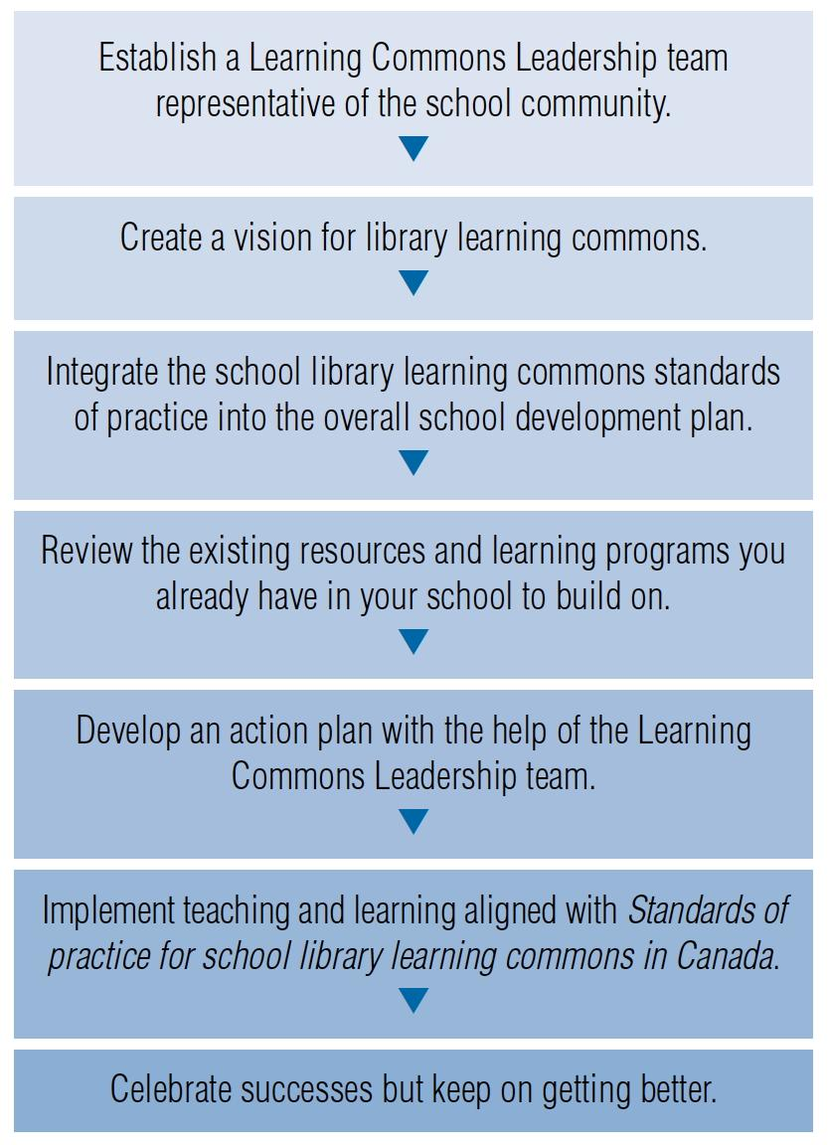
Moving Forward
Key Steps for Implementation: Essential Process and Conditions for Success

Slide 41
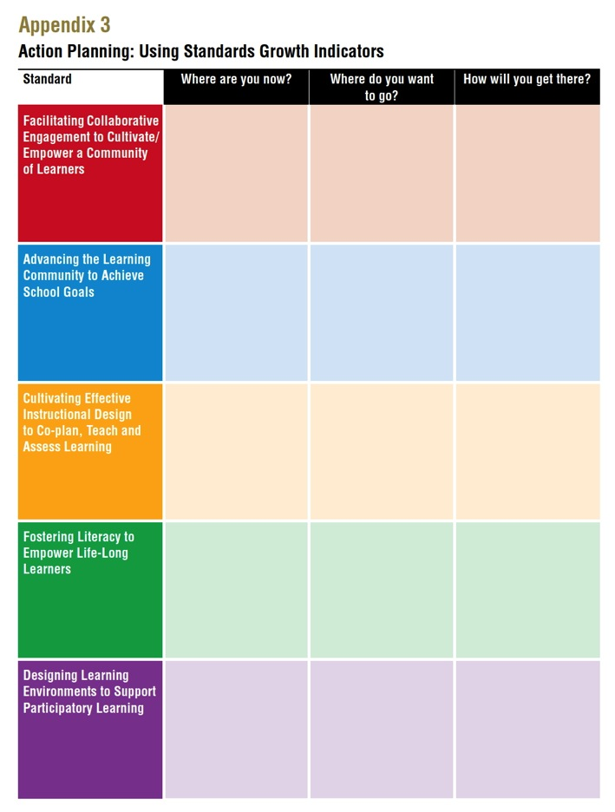
How can your school use Leading Learning to advance school improvement?
Appendix 3
See page 32
Notes:
Transitioning to effective school learning commons practice is a continuous journey that takes different amounts of time for schools. It is a whole school responsibility using a team approach with varied roles and responsibilities. The important part is to begin and keep getting better!
The indicators and “see it in action” examples from all across the country can be used as a guideline to chart growth of the learning commons in the school. From the information collected, goals and actions can be set, and a learning commons plan developed, implemented and sustained.
Look into the document for strategies and tools schools can use.
Hyperlink to Leading Learning

Slide 42
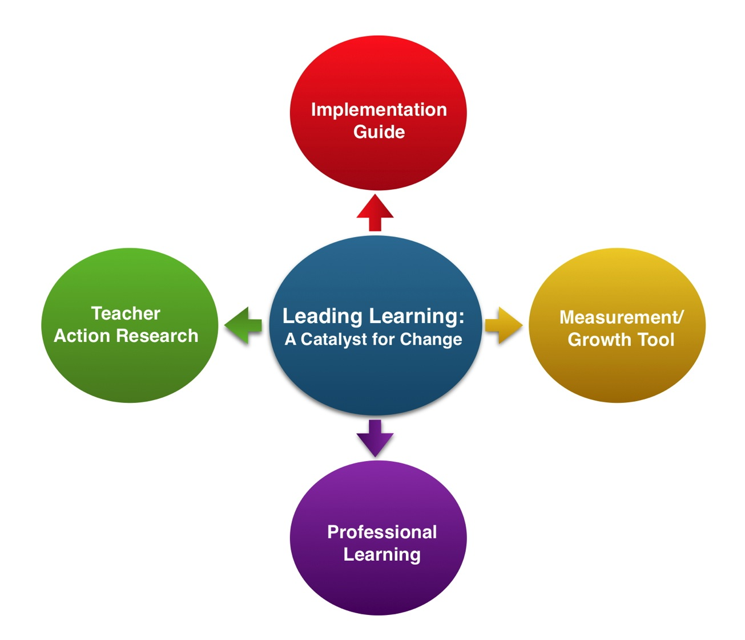
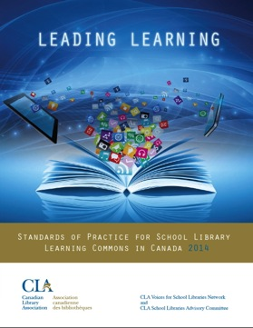

Slide 43
School Libraries in Québec
APSDS (Association pour la promotion des services documentaires scolaires)
QSLiN (Québec School Librarians Network)
ABQLA (Includes School Libraries section)
Nine English school boards
School boards have professional librarians who work at the board / district level
Some school boards (not all) have library technician working in the schools
Part-time or full-time
Inconsistent: some school libraries run by volunteers
Ministry actively working to improve this situation

Slide 44
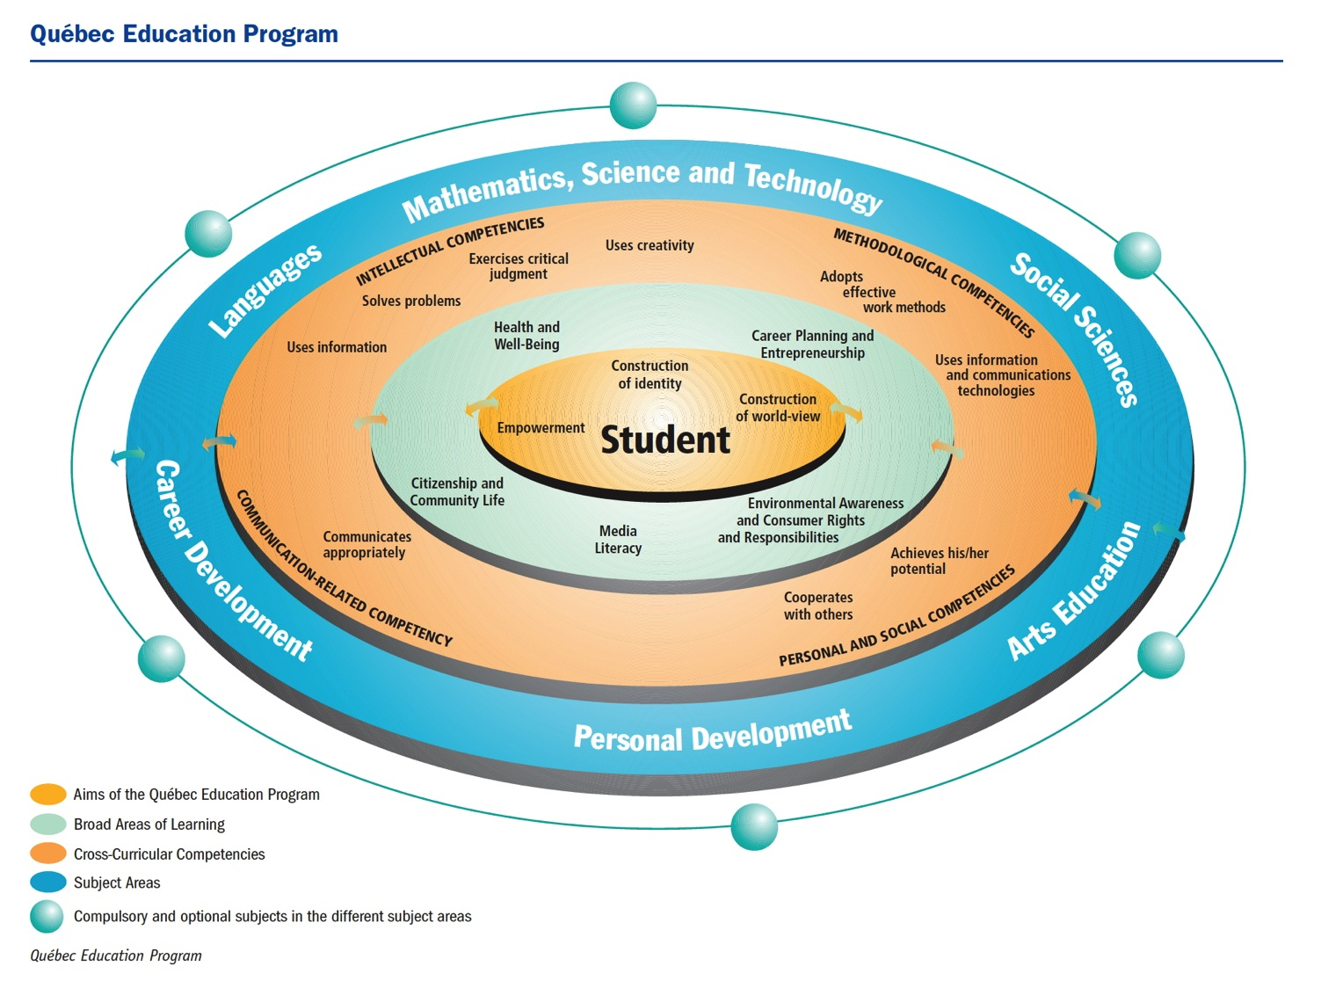
Cross-Curricular Competencies

Slide 45
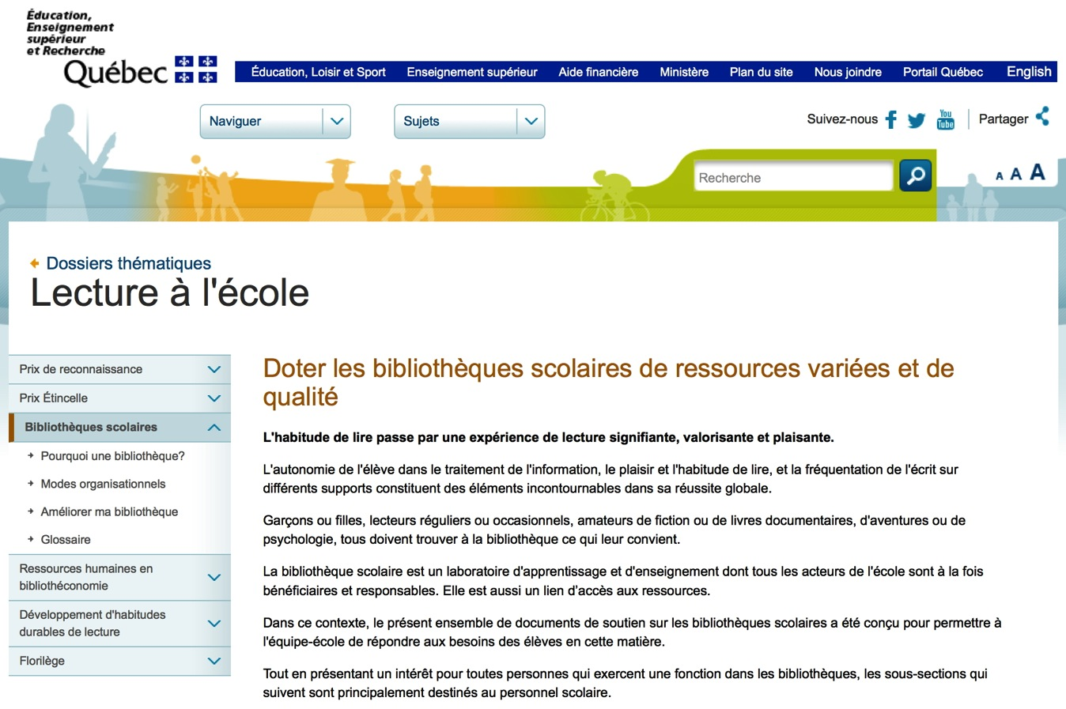
Québec Ministry of Education, Leisure and Sport

Slide 46
Québec Ministry of Education, Leisure and Sport
Action Plan for Reading at School
Le ministère de l'Éducation, de l'Enseignement supérieur et de la Recherche poursuivra le réinvestissement qui a débuté en 2004-2005 dans les bibliothèques scolaires, en contribuant financièrement à l'acquisition de nouvelles ressources, et permettra aux commissions scolaires d'embaucher une vingtaine de bibliothécaires par année pendant dix ans, soit un total de 200 nouveaux bibliothécaires.
The Minister of Education, Leisure and Sport will continue the reinvestment in school libraries that began in 2004-2005 by contributing financially to the acquisition of new resources, and will permit school boards to hire 20 librarians per year for 10 years, to reach a total of 200 new librarians.
http://www.mels.gouv.qc.ca/dossiers-thematiques/lecture-a-lecole/ressources-humaines-en-bibliotheconomie/

Slide 47
“It is encouraging to learn that after many difficult years struggling with very few resources and a true marathon of report writing, lobbying activities and mobilization, school libraries in Québec now benefit from a ten-year program for their development.”
The Future Now: Canada’s Libraries, Archives and Public Memory
Royal Society of Canada Expert Panel Report (2014).

Slide 48
School board librarians working directly with Ministry consultants!

Slide 50
Teacher-librarians have the specialized skills, knowledge and training to implement needed change. Volumes of research point to the positive influence excellent teacher-librarians have on teaching and learning. Each school and district should work creatively to ensure that all students have the benefit of teacher-librarian expertise in information literacy and technology in learning as well as in supporting independent reading and evolving literacies.
- Leading Learning, p. 21

Slide 51
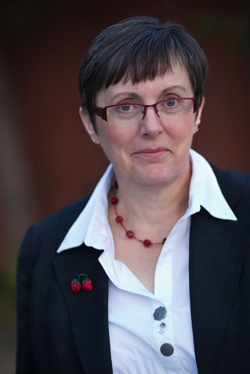
Remember: Leading Learning provides a framework for growth!
All schools can find their place and decide on strategies for improvement.
No matter the library
staffing structure, there must be some kind of teacher leadership to keep the library learning commons program focused on learning and relevant to the school’s learning goals.
Think about how that can be accomplished in your school or district.

Slide 52
Libraries
School
Post-Secondary
Special
Public
Are there any take-aways from Leading Learning that have relevance for other library sectors?
What can other
members of the “library ecosystem” do to increase awareness of Leading Learning and advance the role of school libraries?

Slide 53
You can find my presentation and related links on my website:
www.bythebrooks.ca
Presentations ➔ Presentations Archive ➔ ABQLA May 2015
Anita Brooks Kirkland
www.bythebrooks.ca
Consultant, Libraries & Learning
Past-President (2014), Ontario Library Association
@AnitaBK

