Slide 1
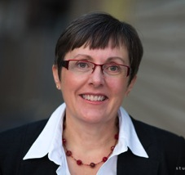
The Connected Teacher-Librarian
Together…
… for Learning
York Catholic District School Board
February 15, 2013
Anita Brooks Kirkland
Consultant, K-12 Libraries, Waterloo Region DSB
www.bythebrooks.ca
@AnitaBK

Slide 2
F
E
A
R
CURRICULUM
FUNDING
Photo: Adam Carter/CBC
STAFFING
CRISIS IN SCHOOL LIBRARIES!!!

Slide 3
F
E
A
R

Slide 4
Strategies for dealing with our fears and moving forward.

Slide 5
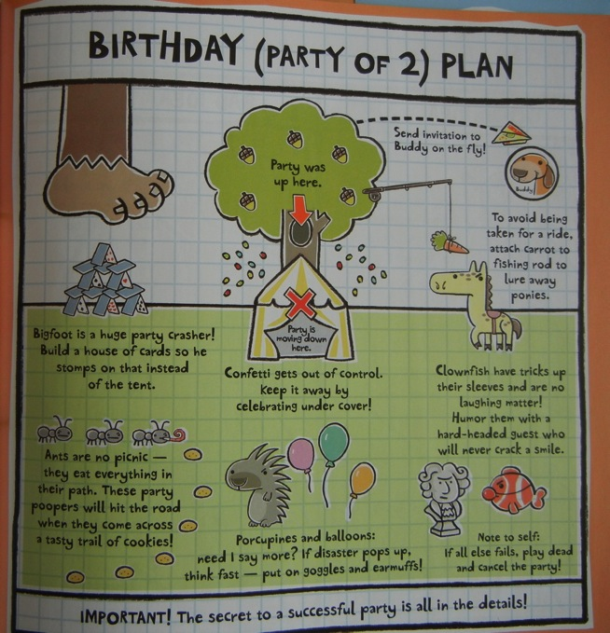

Slide 7
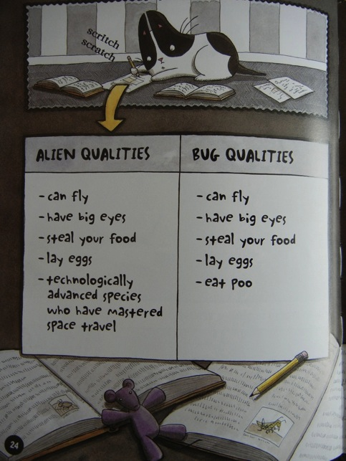
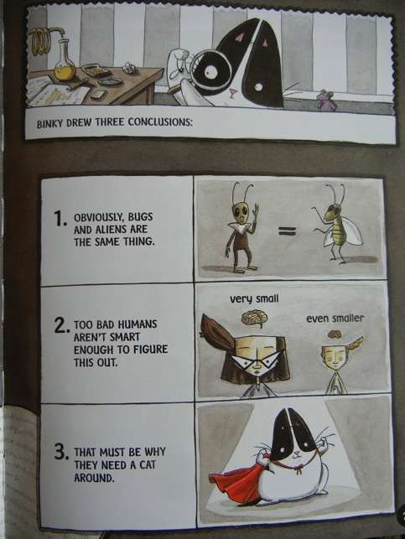

Slide 9
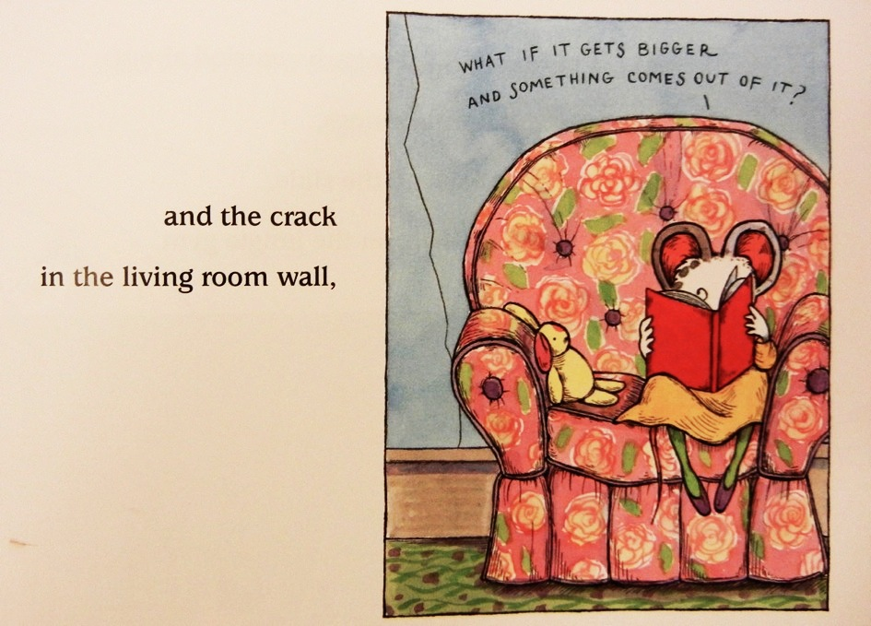

Slide 10
Scaredy’s Strength:
Self-awareness and
a good plan.
Binky’s Approach:
Unbridled optimism.
Wemberly’s Key to Success:
Allies and a support network.

Slide 11
Responding to an Era of Complex Change
Swift advances in information & communications technology effecting major changes in society, economy, politics, science
Altering the way people work, play
& learn
Schools are being challenged to harness the unfamiliar yet incredibly fascinating opportunities presented by this transformation... all while ensuring students emerge with the skills they need, not only to survive, but to thrive. Development of a Learning Commons addresses this challenge.

Slide 12
What is a Learning Commons?
Flexible & responsive
Focus on collaborative learning
Leverages physical & virtual spaces
Whole-school approach
Opportunities for collaboration –
teachers, teacher-librarians, students
Leverages technology to facilitate
collaboration
Leverages role of library as a space naturally designed to facilitate people working together

Slide 13
Within a Learning Commons, new relationships are formed between learners, new technologies are realized and utilized, and both students and educators prepare for the future as they learn new ways to learn.

Slide 14
Physical & Virtual Spaces
Design components foster collaboration, comfort & community
Learning is fluid & participatory
Spaces encourage collegiality & intellectual development
Age of ultra-connectivity makes virtual learning spaces possible
Collaborative learning, 24/7

Slide 15
Equitable Access
Wide and growing range of media, information sources, technologies
Physical & virtual collections
Access to qualified staff
Fluid schedule, on as-needed basis
Access during and outside school day

Slide 16
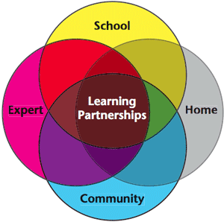
Learning Partnerships
Everyone is engaged in learning – teachers & students
Teacher as coach & facilitator
Includes all members of the school community
Learning opportunities are:
Global, connected and social
Real world, cross-curricular, and interdisciplinary
Active, fluid, and flexible
Complex and resource-rich
Respectful of all ideas

Slide 17
Technology in Learning
Social media for learning and developing deeper understanding
Critical and creative thought
Constructing meaning
Shared learning experiences
Diverse resources
Using the tools available in the communication world outside of school is one way to bridge the learning gap experienced by students today.

Slide 18
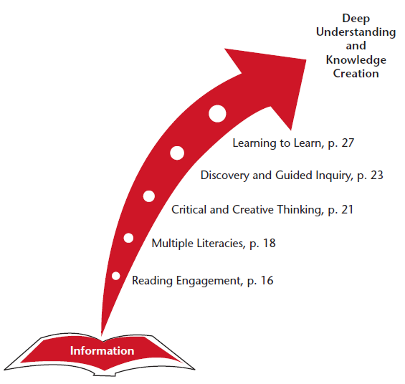
Learning
To
Learn
Seeing everyone as a learner is at the crux of the Learning Commons.

Slide 19
Binky’s Approach:
Unbridled optimism.
So is T4L just an idealistic pipe dream?

Slide 20
iStockPhoto.com

Slide 21
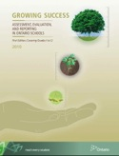
Connections?

Slide 22
So let’s make the connections.
We must understand and be able to demonstrate how we are connected to the goals and strategic priorities of education in Ontario and in our school districts.
Scaredy’s Strength:
Self-awareness and
a good plan.

Slide 23
What We Do
Our plan to promote a strong, vibrant, publicly funded
education system is focused on three core priorities:
* High levels of student achievement
* Reduced gaps in student achievement
* Increased public confidence in publicly funded education
http://www.edu.gov.on.ca/eng/about/whatwedo.html

Slide 24
The Ontario Curriculum
The Role of the School Library
The school library program can help to build and transform students' knowledge to support a lifetime of learning in an information- and knowledge-based society… In collaboration with classroom or content-area teachers, teacher-librarians develop, teach and provide students with authentic information and research tasks that foster learning.

Slide 25
The Ontario Curriculum
Inquiry/Research Skills
Inquiry is at the heart of learning in all subject areas… As [students] advance through the grades, they acquire the skills to locate relevant information from a variety of sources that can help them answer the questions they pose… The questioning they practiced in the early grades becomes more sophisticated as they learn that all sources of information have a particular point of view and that the recipient of the information has a responsibility to evaluate it, determine its validity and relevance, and use it in appropriate ways. The ability to locate, question, and validate information allows a student to become an independent, lifelong learner.

Slide 26
A Guide to Effective Instruction in Reading, Kindergarten to Grade 3
Motivation to read is the essential element for actively engaging students in the reading process. Students need to be immersed in a literacy-rich environment, filled with appealing books, poems, pictures, charts, and other resources that capture their interest and entice them to read for information and pleasure. Students need to see themselves as successful readers.
Independent Reading: Texts are carefully selected – some by the teacher, others by students, with teacher support – to ensure that each child has a successful independent reading experience.

Slide 28
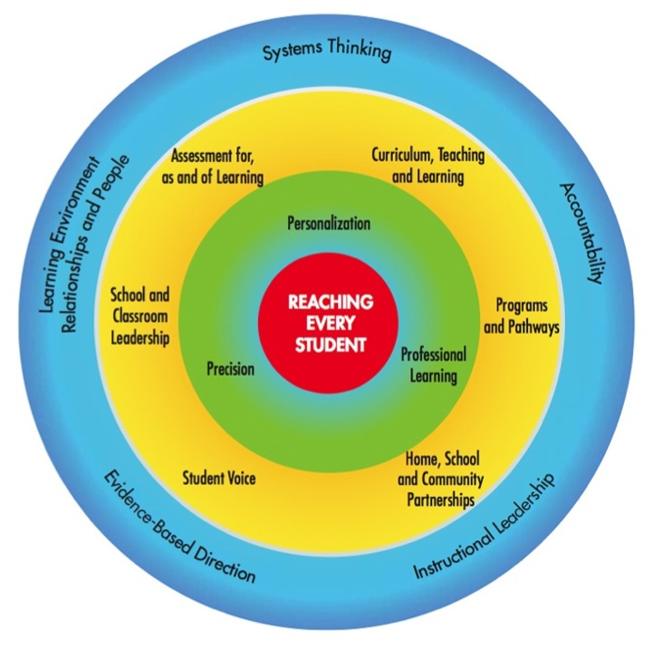

Slide 29
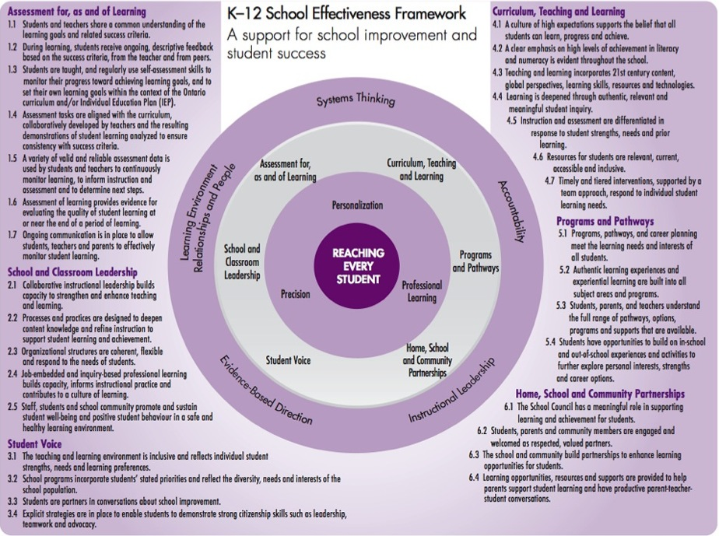

Slide 30
Collaborative instructional leadership
Job-embedded, inquiry-based professional learning contributes to culture of learning
21st century content, global perspectives, learning skills, resources and technologies
Authentic learning experiences
Assessment for, as and of learning
Resources for students are relevant, current, accessible and inclusive
Community partnerships

Slide 31
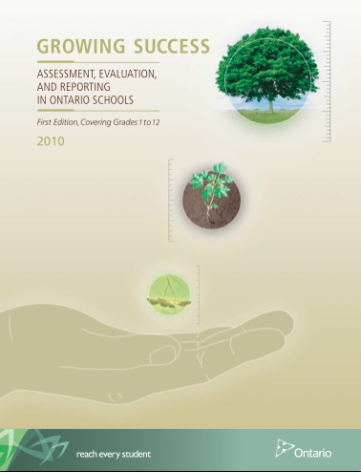

Slide 32
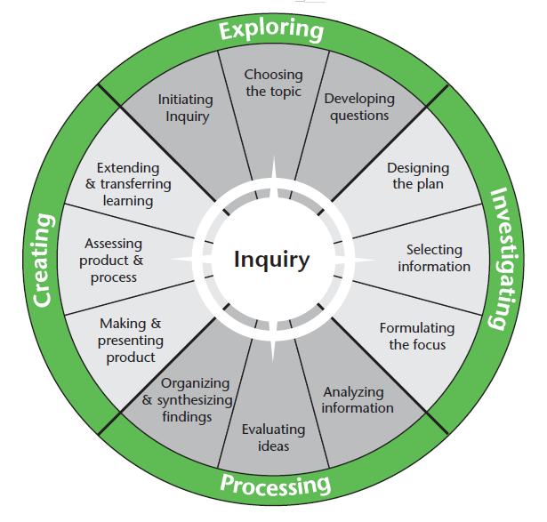
Discovery & Guided Inquiry
Assessment FOR, AS & OF Learning!

Slide 33
Achievement Chart
Knowledge and Understanding: There is potential for deeper understanding through the guided inquiry process
Thinking: Guided inquiry fosters use of critical and creative thinking skills and/or processes
Communication: Guided inquiry encourages students to convey meaning through various forms
Application: Guided inquiry helps students make connections within and between various contexts

Slide 34
Assessment…
For Learning: Diagnostic
Of Learning:
Summative
For Learning: Formative
As Learning: Formative
As Learning: Formative
For Learning: Formative
As Learning: Formative

Slide 36
Our Shared Vision
We are a Catholic Learning Community of collaborative
partners, called to serve one another by being committed to and accountable for quality learning by all, with Jesus as our inspiration.
We are committing to continually improving our schools, creating environments where everyone interacts and innovation and improvement are built into our daily activities; where we, as a Catholic Learning Community, can come together to reflect on our best practices, assess our effectiveness and make decisions about what we need to do to become even more effective; where we are all engaged in a common purpose; and where we rely on each other to reach agreed upon goals that we could not achieve independently.

Slide 37
Our Shared Vision
We are a Catholic Learning Community of collaborative
partners, called to serve one another by being committed to and accountable for quality learning by all, with Jesus as our inspiration.
We are committing to continually improving our schools, creating environments where everyone interacts and innovation and improvement are built into our daily activities; where we, as a Catholic Learning Community, can come together to reflect on our best practices, assess our effectiveness and make decisions about what we need to do to become even more effective; where we are all engaged in a common purpose; and where we rely on each other to reach agreed upon goals that we could not achieve independently.

Slide 38
✔ Connected in Purpose
Connected to growth &
a vision for the future

Slide 39
Vision
That the Ontario Ministry of Education adopt or adapt Our Vision with education partners to drive a purposeful cultural shift in our education system that
focuses on engaging and inspiring students
fosters creative and innovative minds and
embraces the enabling role of technology in expanding how, when and where learning takes place.
Authentic Student Engagement
Skills for a Digital Age
Inspiring and Inspired Teachers
Responsible Digital Citizenship
Equity of Access and Equity of Opportunity

Slide 40
Ontario over the past decade has resisted this temptation to invest heavily in technological tools. Instead we have built the pedagogical capacity of teachers to teach well and to learn from each other. Now with focused innovation we must invest in new practices that integrate pedagogy and technology, with the former as the driver.

Slide 41
Connected to growth &
a vision for the future
Binky’s Approach:
Unbridled optimism.

Slide 42
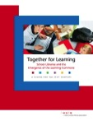
✔ Connected to Each Other
Although Professional Learning Communities are created within a school, they may extend beyond its four walls, to schools within a board where common experiences are occurring. The power comes from the immediacy of contact and collaboration that takes place as ideas are explored.
Personal Learning Networks facilitate the gathering of information, ideas and content. They can inform and incite dialogue and connect participants beyond their local areas. Ultimately, these networks can model the very type of learning that is established in the Learning Commons.
@T4LOntario

Slide 43
✔ Connected to Each Other
www.togetherforlearning.ca
@T4LOntario
Wemberly’s Key to Success:
Allies and a support network.

Slide 44
Leverage Your Unique Value & Contribution
Our colleagues in education don’t necessarily know what we can offer and everything that we can do to move their agendas and our mutual agendas forward.
Be Proactive and Make Connections

Slide 45
iStockPhoto.com

Slide 46
iStockPhoto.com

Slide 47
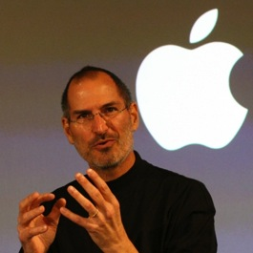
Is Steve Jobs a Role Model for Librarians?
David F. Kohl (2010). Journal of Academic Librarianship 36(3).
Opportunity-Driven Possibilities
Demand-Driven Solutions

Slide 48
iStockPhoto.com

Slide 49
When we come back…
Kicking It Up a Notch
with T4L!

Slide 50
Kicking It Up a Notch
with T4L!

Slide 51
F
E
A
R

Slide 52
F
E
A
R
… of Change.

Slide 53
Change
How will this affect me?
What am I going to do?
How will I have to change?
What if I can’t do it?
iStockPhoto.com

Slide 54
Consider practices through the filters of the new context.
Pretty good but could be better?
Time to kick it up a notch!
No longer aligned?
Time to stop
doing it.
Great idea & aligns well?
Keep doing it!

Slide 55
Consider practices through the filters of the new context.
Pretty good but could be better?
Time to kick it up a notch!
Learning Partnerships
Technology for Learning
Your Goal? To ADD VALUE to the learning experience.

Slide 56
Learning
To
Learn
Seeing everyone as a learner is at the crux of the Learning Commons.

Slide 57
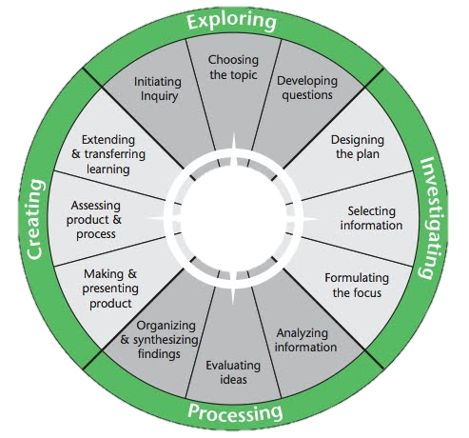
Reading Engagement
Motivating readers
Connecting readers
Supporting readers
Fostering reading communities
Multiple Literacies
Traditional
Information
Media
Visual
Cultural
Digital
Critical
Critical & Creative Thinking
Read & write for
different purposes
Evaluate texts
Navigate & create in
variety of formats
Discovery & Guided Inquiry
Inquiry

Slide 58
Learning
To
Learn
Seeing everyone as a learner is at the crux of the Learning Commons.

Slide 59
www.togetherforlearning.ca
Anita Brooks Kirkland
Consultant, K-12 Libraries, WRDSB
www.bythebrooks.ca
@AnitaBK
library.wrdsb.ca

